Slide 1
Notes:
First, thanks so much for your time today! I’m excited to be the one to introduce you to FIRST programs, and I’m hoping that this will serve as a place for you to gather some information and see how I can support you and your school district to make STEM education available for all your students.

Slide 2
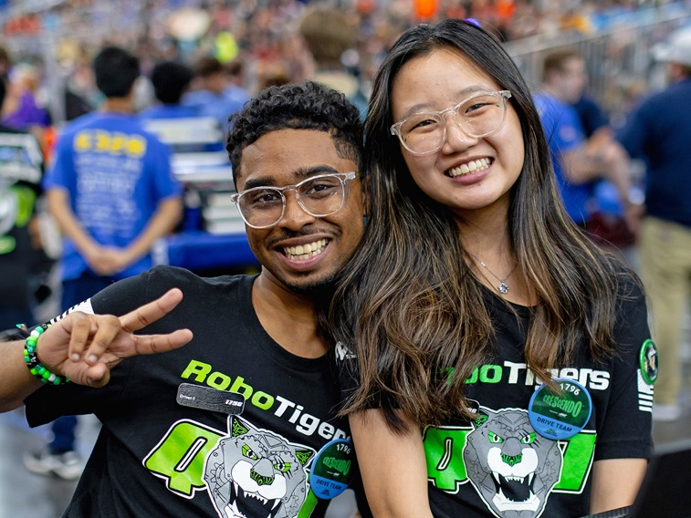
Purpose, Vision, and Mission
PURPOSE
FIRST exists to prepare the young people of today for the world of tomorrow.
MISSION
The mission of FIRST is to provide life-changing robotics programs that give young people the skills, confidence, and resilience to build a better world.
IMPACT
Reaching over 3.2 million students participants around the world since 1989, FIRST programs have a proven impact on learning, interest, and skill-building inside and outside of the classroom.
Notes:
So who is FIRST? FIRST is an acronym that stands for For Inspiration and Recognition of Science and Technology. We are the world’s leading youth-serving nonprofit that advances STEM education with over 3.2 million youth served in over 110 countries. In short, we help students get into careers in STEM. And the way that we do that is by offering HANDS ON programming by way of robotics competitions.

Slide 3
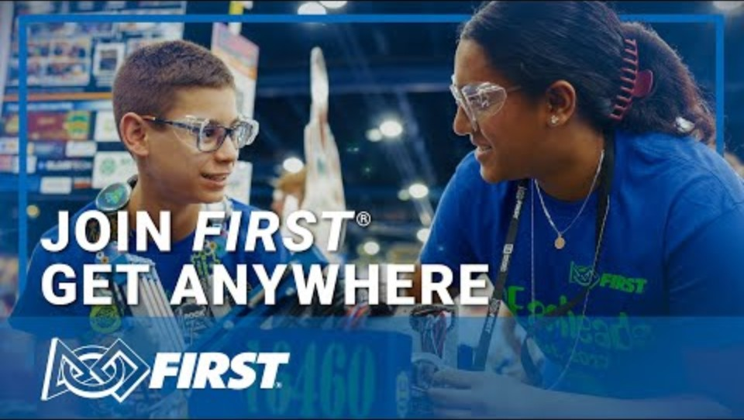
Get Anywhere with FIRST

Slide 4
A Suite of Hands-On STEM Learning Programs
Experience a FIRST® program throughout the school year.
Our Keys to Success
Through a suite of team-based robotics challenges and backed by a global network of mentors, coaches, volunteers, alumni, and sponsors, FIRST helps young people discover a passion for STEM and develop the skills they'll need to succeed in today's workforce.
A theme-corresponding challenge that changes year over year.
Community that supports and promotes student success.
An experience that creates well-rounded professionals.
Children can join any of our three programs based on age or grade level. Ages may vary by region.
Notes:
FIRST Robotics has 3 main programs that serve students anywhere between PreK to 12th grade. In each of our programs, students operate as a team lead by at least two adults where they learn key workforce skills by building and coding robots to compete against other teams in their communities.
We find that the secret to developing students into high-achieving STEM professionals comes down to 3 key components that you’re going to see in our programs:
#1 is a challenge.
Every year, the competition format changes corresponding to an annual theme that is announced at our national competition, so no two seasons are the same. Last year’s theme was Dive, an ocean/underwater inspired theme. This year’s theme is Age, our archaeology inspired competition. A game that changes year over year keeps students engaged and challenges them to build new skills to master the competition every season.
#2 is community.
Being part of the FIRST community builds students up to be the best that they can be. An important term you’ll see throughout each of our programs is what’s called “Gracious Professionalism”.
Gracious professionalism is a core value of ours at FIRST. It isn't about being nice, but about having a strong, positive attitude and seeking to uplift others while working collaboratively to achieve shared goals. An example that you’ll see of this is at our FIRST Robotics Competition. At each of our events, we have an admin table where if a team needs help, like they’re looking for an additional part, and the admin will announce it over the speaker, “Team 1049 is looking for a jig saw,” or something. And sure enough, you will see students RUN to the teams booth saying, “Here’s a jig saw, how else can we help?” It’s a profound experience when you see teams building and supporting the community.
#3 is a well-rounded experience. Something you’ll hear in our community is that FIRST is more than robots, and that’s true! Throughout each season of our programs, students learn high demand workforce skills like coding, assembling, and manufacturing which prepares them for careers in STEM, and they also learn skills like public speaking, working as part of a team, and much more. Most of the awards are not based on how well the robot does in competition, but how well students are supporting STEM in their communities and how well they are articulating their team’s strategy and design process.
All three of these key components come together to help students develop high-demand skills while igniting a PASSION for STEM.

Slide 5
Program Introductions
Notes:
So what I’d like to do with you today is go over each of our programs, and give you the basic information about our programs, and as you have questions, feel free to ask them!

Slide 6
Notes:
Our first program is FIRST Lego League

Slide 7
FIRST® Lego League Challenge Overview
Description
Friendly competition is at the heart of Challenge, as teams of students engage in research, problem-solving, coding, and engineering - building and programming a LEGO® Education SPIKE™ Prime robot that navigates the missions of a robot game. They also participate in a research project to identify and solve a relevant real-world problem.
Season Timeline
May – Registration Opens
September – Kickoff
December-January – Competition Season
January – State Competition
April – National Competition
Student Age Range
9-14 (4th-8th Grade)
Need to Start A Team
2 or more adult lead coaches
2-10 students
Notes:
FIRST Lego League is our introductory program, where we seek to ignite a passion for STEM. Within FIRST Lego League, we have 3 main sub-programs (Discover, Explore, and Challenge), with each program providing students with challenges and programming suited to their age. The main sub-program that I want to talk about today is FIRST Lego League Challenge, which is for students between 4th and 8th grade. As part of challenge, students use Lego Spike Prime kits to build completely autonomous robots out of Lego and compete against other teams in a mission-based game where the robot scores points based on how many missions they complete.
Aside from robotics, students also build an innovation project with potential solutions pertaining to issues surrounding the theme of the year. Corresponding to this last year’s theme of Dive, students researched problems experienced by people who explore the ocean. There was one team that I judged this last season whose problem was that there’s no “black boxes” on submarines.

Slide 8
Notes:
Our next program is FIRST Tech Challenge.

Slide 9
FIRST® Tech Challenge Overview
Description
FIRST® Tech Challenge students work together with their mentors to design and build robots to compete in a dynamic and exciting challenge released every September. Teams program classroom-scale robots to follow autonomous commands before student drivers take control in two-on-two matches.
Season Timeline
May – Registration Opens
September – Kickoff
October-February – Competition Season
February – State Competition
April – National Competition
Student Age Range
12-18 (7th-12th Grade)
Need To Start A Team
2 or more adult mentors
2-15 students
Notes:
FIRST Tech Challenge is our middle school to high school program.
In FIRST Tech Challenge (or FTC as you’ll hear it called) teams program classroom-scale robots (within 1.5 cubic feet) to compete in two on two matches beginning with an autonomous (not controlled) and followed by a tele-op (human controlled) period. Off the field, students engage in community outreach and practice engineering innovation. While this program is a bit more of a challenge than FIRST Lego League Challenge, there are options to make the program more accessible for beginners, like the option of using block code or Java. FIRST Tech Challenge also doesn’t require large-scale power-tools to be successful. Most teams focus on purchasing parts for design and assembly of their bot rather than manufacturing parts for the bot.
Compared to FIRST Robotics Competition, which you’ll learn about here in a second, FTC is a longer season with the game dropping in September, and competition season happening between October and February.

Slide 10
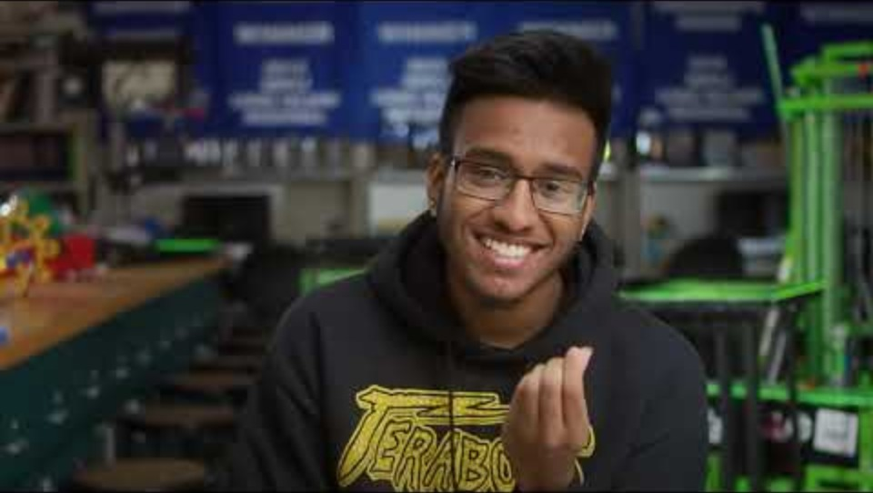
FTC from the Students

Slide 11
Notes:
Finally, we come to our final program, FIRST Robotics Competition.

Slide 12
FIRST® Robotics Competition Overview
Description
  Starting with a Kit of Parts, teams of high school students design, program, and build industrial-sized robots to play an action-packed game, released in January. They compete on a themed field as part of a three-team alliance in the spirit of Coopertition®
  Season Timeline
  May – Registration Opens
  May-January – Off-Season Events (fundraising, training, etc.)
  January – Season Kickoff
  February-March – Competition Season
  April – State Competition
  April – National Competition
  Student Age Range
  14-18 (9th-12th Grade)
  Need To Start A Team
  2 or more adult mentors
    No robotics experience required
  10+ students
Notes:
FIRST Robotics Competition, or FRC, is the ultimate sport for the mind. It is our most advanced and intense robotics program, and is designed for students between 9th and 12th grade. In January, students are given between 6 and 8 weeks to design, build, program, and test a fully functional industrial-scale robot to compete in the game. These robots can weigh over 120 pounds, and are custom built from raw materials like aluminum, polycarbonate, and steel. Teams also use professional-grade tools like CAD (or computer assisted design) and advanced programming languages like Java and C++.
FRC events are high production value and have fast-paced matches with music, lights, and enthusiastic crowds. During the event, students present to judges for awards on robot design and community impact. The community surrounding FRC is a bit different as well, it’s not uncommon to see students gaining internships, college offers, and job offers directly because of their FRC experience.
FRC Teams operate more like a start up, and are meant to be more self-sustaining. Many teams have students whose roles are outside of building the bot, like marketing and fundraising, or project management. Keeping this in mind, most FRC teams have at least 10 students, and there is no cap on the number of students that can be on a team. With this wide range of roles and skills that are developed in FRC, this program can be a home for students that are interested in the skilled trades, or business, or even digital art and design.
FRC students are also typically more specialized, where students will typically fall into roles that align with specific skills they want to develop and contribute to the team. For example, you’ll have students that are interested in building a Computer Science career exclusively work on the coding of the bot, while another student who is more interested in mechanical engineering designing specific mechanical components to the bot.
The last thing that I want to say about this program now is that while FRC is our greatest challenge for students, there is no robotics experience necessary for teachers or students. Teams that are new to the program, we call them rookies, they’re going to receive a ‘kit bot’ which comes with a set of clear instructions to build, code, and wire your bot. We even have code for the bot downloadable on our website, so while this is program poses a steep challenge, new teams have the resources to succeed.

Slide 13
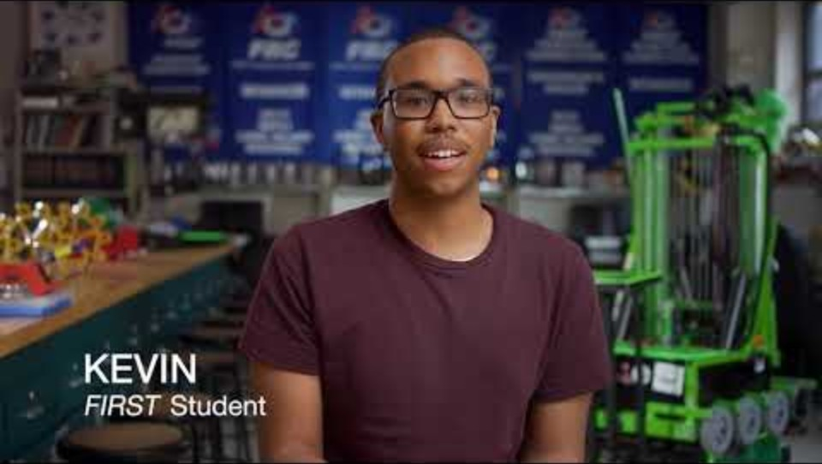
FRC from the Students
Notes:
Link to video: https://youtu.be/SJf6iG_SDE8?si=SRoCvW5y0Cp6dHJl

Slide 14
Program Comparison
Program Categories | FIRST Robotics Competition (9th-12th Grade) | FIRST Tech Challenge (7th-12th Grade)
Robot Size | Up to ~125 lbs, large field (26’ x 54’) | ~18” cube, smaller field (12’ x 12’)
Programming | Java, C++, LabVIEW, Python | Java, Blocks, Chromebook compatible
Hardware | Custom metal builds with motors, pneumatics, sensors, vision, etc. | REV, TETRIX systems; AI/ML/AR supported, open to fully custom construction
Season Experience | Highly intensive, “sport of the mind,” regional → FIRST Championships | Flexible formats, scalable events, regional → FIRST Championships
Student Experience | Specialization, Sectional/Departmental Team | All-stars, general skill building
Team Size | 10+ recommended to start, 15-25 for sustainability | ~5–15 typical
Notes:
I’d like to draw some comparisons between FIRST Tech Challenge and FIRST Robotics Competition. Some key comparisons:
The Bot –
Manufacturing VS Assembly
Coding Differences?
Student Experience –
Design process?
FRC, one main design, small tweaks
FTC, multiple redesigns possible
Season Experience?
FRC, high intensity short season
FTC, longer season more flexibility
Specialization vs. All-Stars
Team sizes –
FTC teams: 5-15 students (so all students can work on bot)
FRC teams should typically have at least 15-25 students, and have no cap. Emulates a small business.

Slide 15
FIRST® Program Outcomes
Notes:
So, we have a few great programs, but none of this matters if we don’t have outcomes! I’d like to give you an idea of the outcomes you can expect in your district through the FIRST experience. (next slide)

Slide 16
FIRST® Program Outcomes
  FIRST STUDENTS ARE SIGNIFICANTLY MORE LIKELY TO SHOW GAINS IN STEM OUTCOMES THAN COMPARISON STUDENTS.
    FIRST STUDENTS ARE MORE LIKELY TO TAKE ENGINEERING OR COMPUTER SCIENCE COURSES.
STEM Interest
STEM Career Interest
STEM Knowledge
STEM Activity
STEM Identity
2x
Engineering
2x
Computer Science
2.7x
Full study can be found at: www.firstinspires.org/about/impact
Notes:
In data that we gathered from a 10-year longitudinal study ran by a 3rd party, we have found that FIRST students are achieving at a higher level of STEM outcomes. Our students are twice as likely as the control group to show more STEM interest, STEM Career Interest, STEM knowledge, participate in STEM activities, and identify themselves as belonging in the STEM field. Students are also more likely to take advantage of STEM courses within their schools, with FIRST students being twice as likely to participate in Engineering courses and over 2.5 times as likely to participate in Computer Science courses.

Slide 17
FIRST® Program Outcomes
Full study can be found at: www.firstinspires.org/about/impact
Notes:
And we’re seeing this trend follow into higher education, with more than 80 percent of FIRST students in a STEM major by their 4th year of college and over 60 percent of FIRST students in SPECIFICALLY Engineering or Computer science majors by their 4th year of college. Now, the key to this data is that it’s students by their 4th year, so students aren’t just going to college for a year, declaring a major, and then dropping out or changing majors, FIRST is giving them the skills and CONFIDENCE that is VITAL to success in higher education and the workforce.

Slide 18
FIRST® Program Outcomes
93%
90%
95%
Full study can be found at: www.firstinspires.org/about/impact
Notes:
But it’s not just about STEM skills! Throughout all our programs, students earn awards based on elements like community service, presentation skills, and advancing STEM in their community. Because of our emphasis on a holistic experience, students advance in soft skills, with over 90% of students showing gains in problem solving, communication, and time management skills.

Slide 19
Resources for your success:
Curriculum and other Educator Resources
  At FIRST®, we believe STEM is for everyone, and there's no better to way to make learning fun and relevant for students than with robotics. Find engaging ways to expand student STEM knowledge with free FIRST activities, camp guides, Kahoot content and more.
  Certified Professional Development
  FIRST® Certified Professional Development is an immersive learning experience designed for teachers, facilitators, coaches, and mentors to acquire or strengthen project-based learning facilitation skills and gain experience with all aspects of their chosen FIRST program.
  Industry Certifications
  FIRST® students gain access to real-world certifications that boost college and career readiness. These stackable credentials demonstrate technical proficiency across industries such as manufacturing, engineering design, computer science, and more.
  CTE Alignment Standards
  Aligned with Career and Technical Education (CTE) standards, our course levels support a progression from foundational exploration to advanced technical skills and community-driven capstone work
  Full Training Catalogue
  A full training catalogue with modules for both students and educators to prepare you for building a team.

Slide 20
Notes:
First, thanks so much for your time today! I’m excited to be the one to introduce you to FIRST programs, and I’m hoping that this will serve as a place for you to gather some information and see how I can support you and your school district to make STEM education available for all your students.

