Slide 1



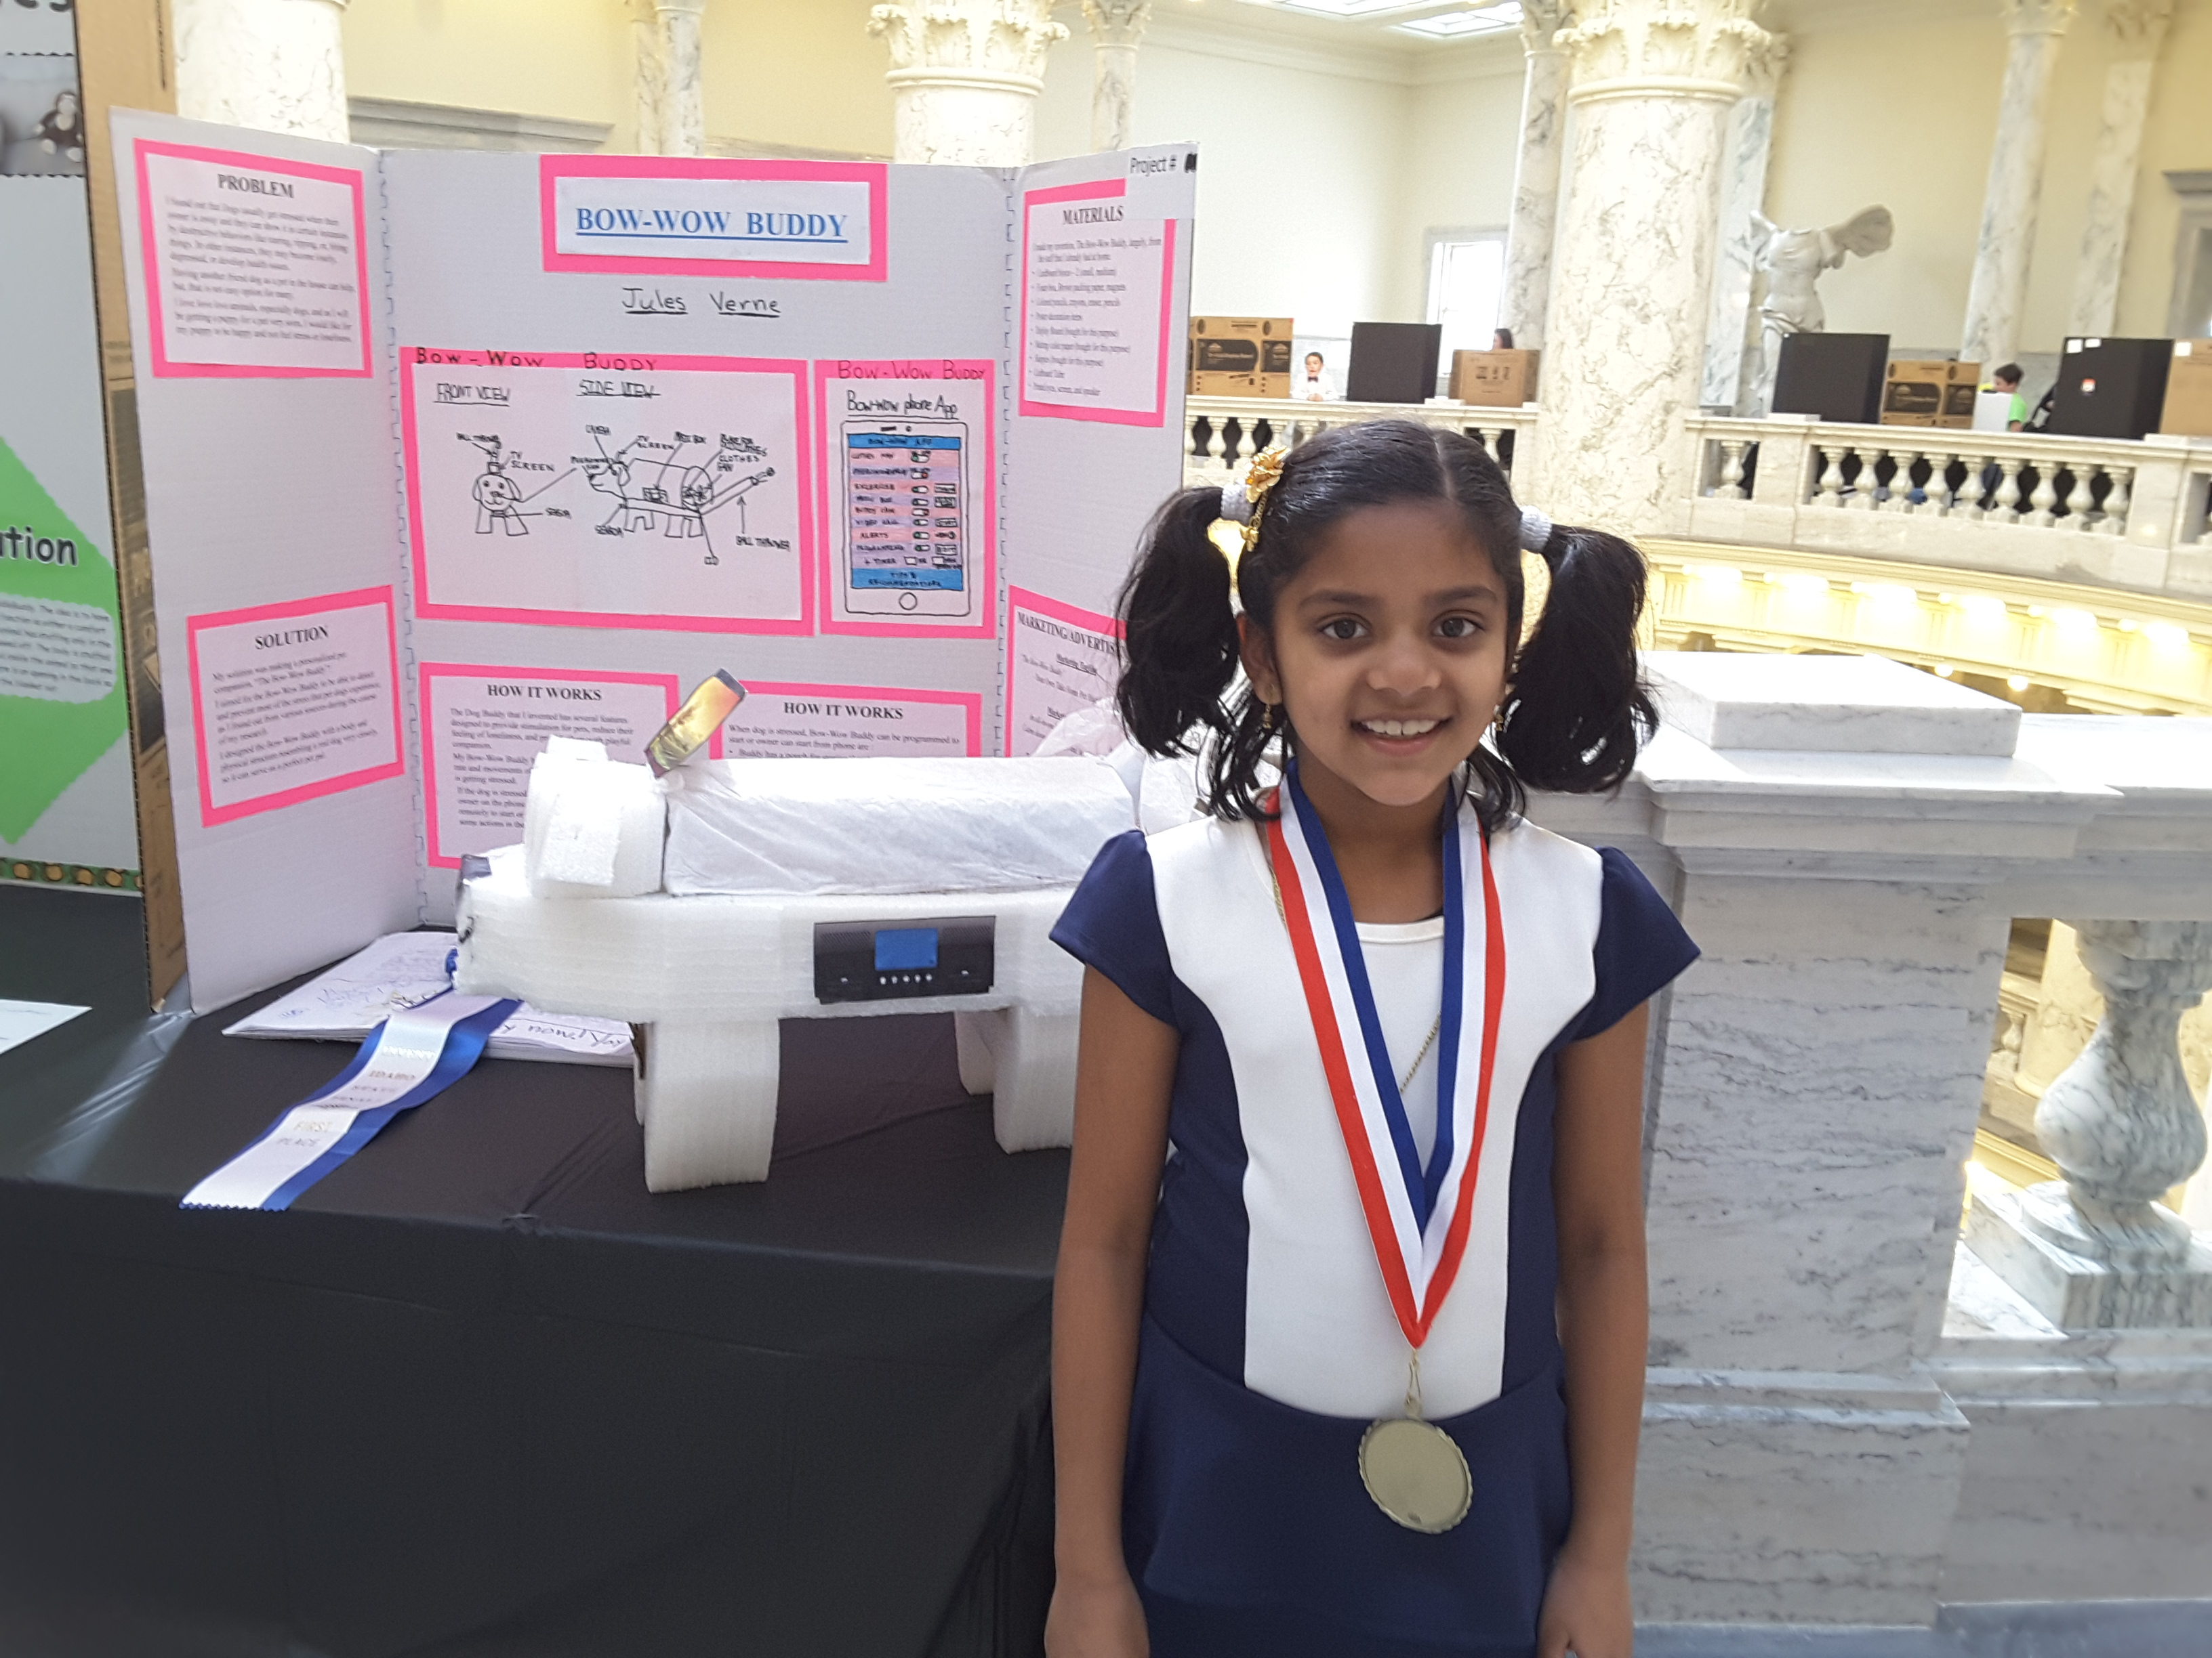
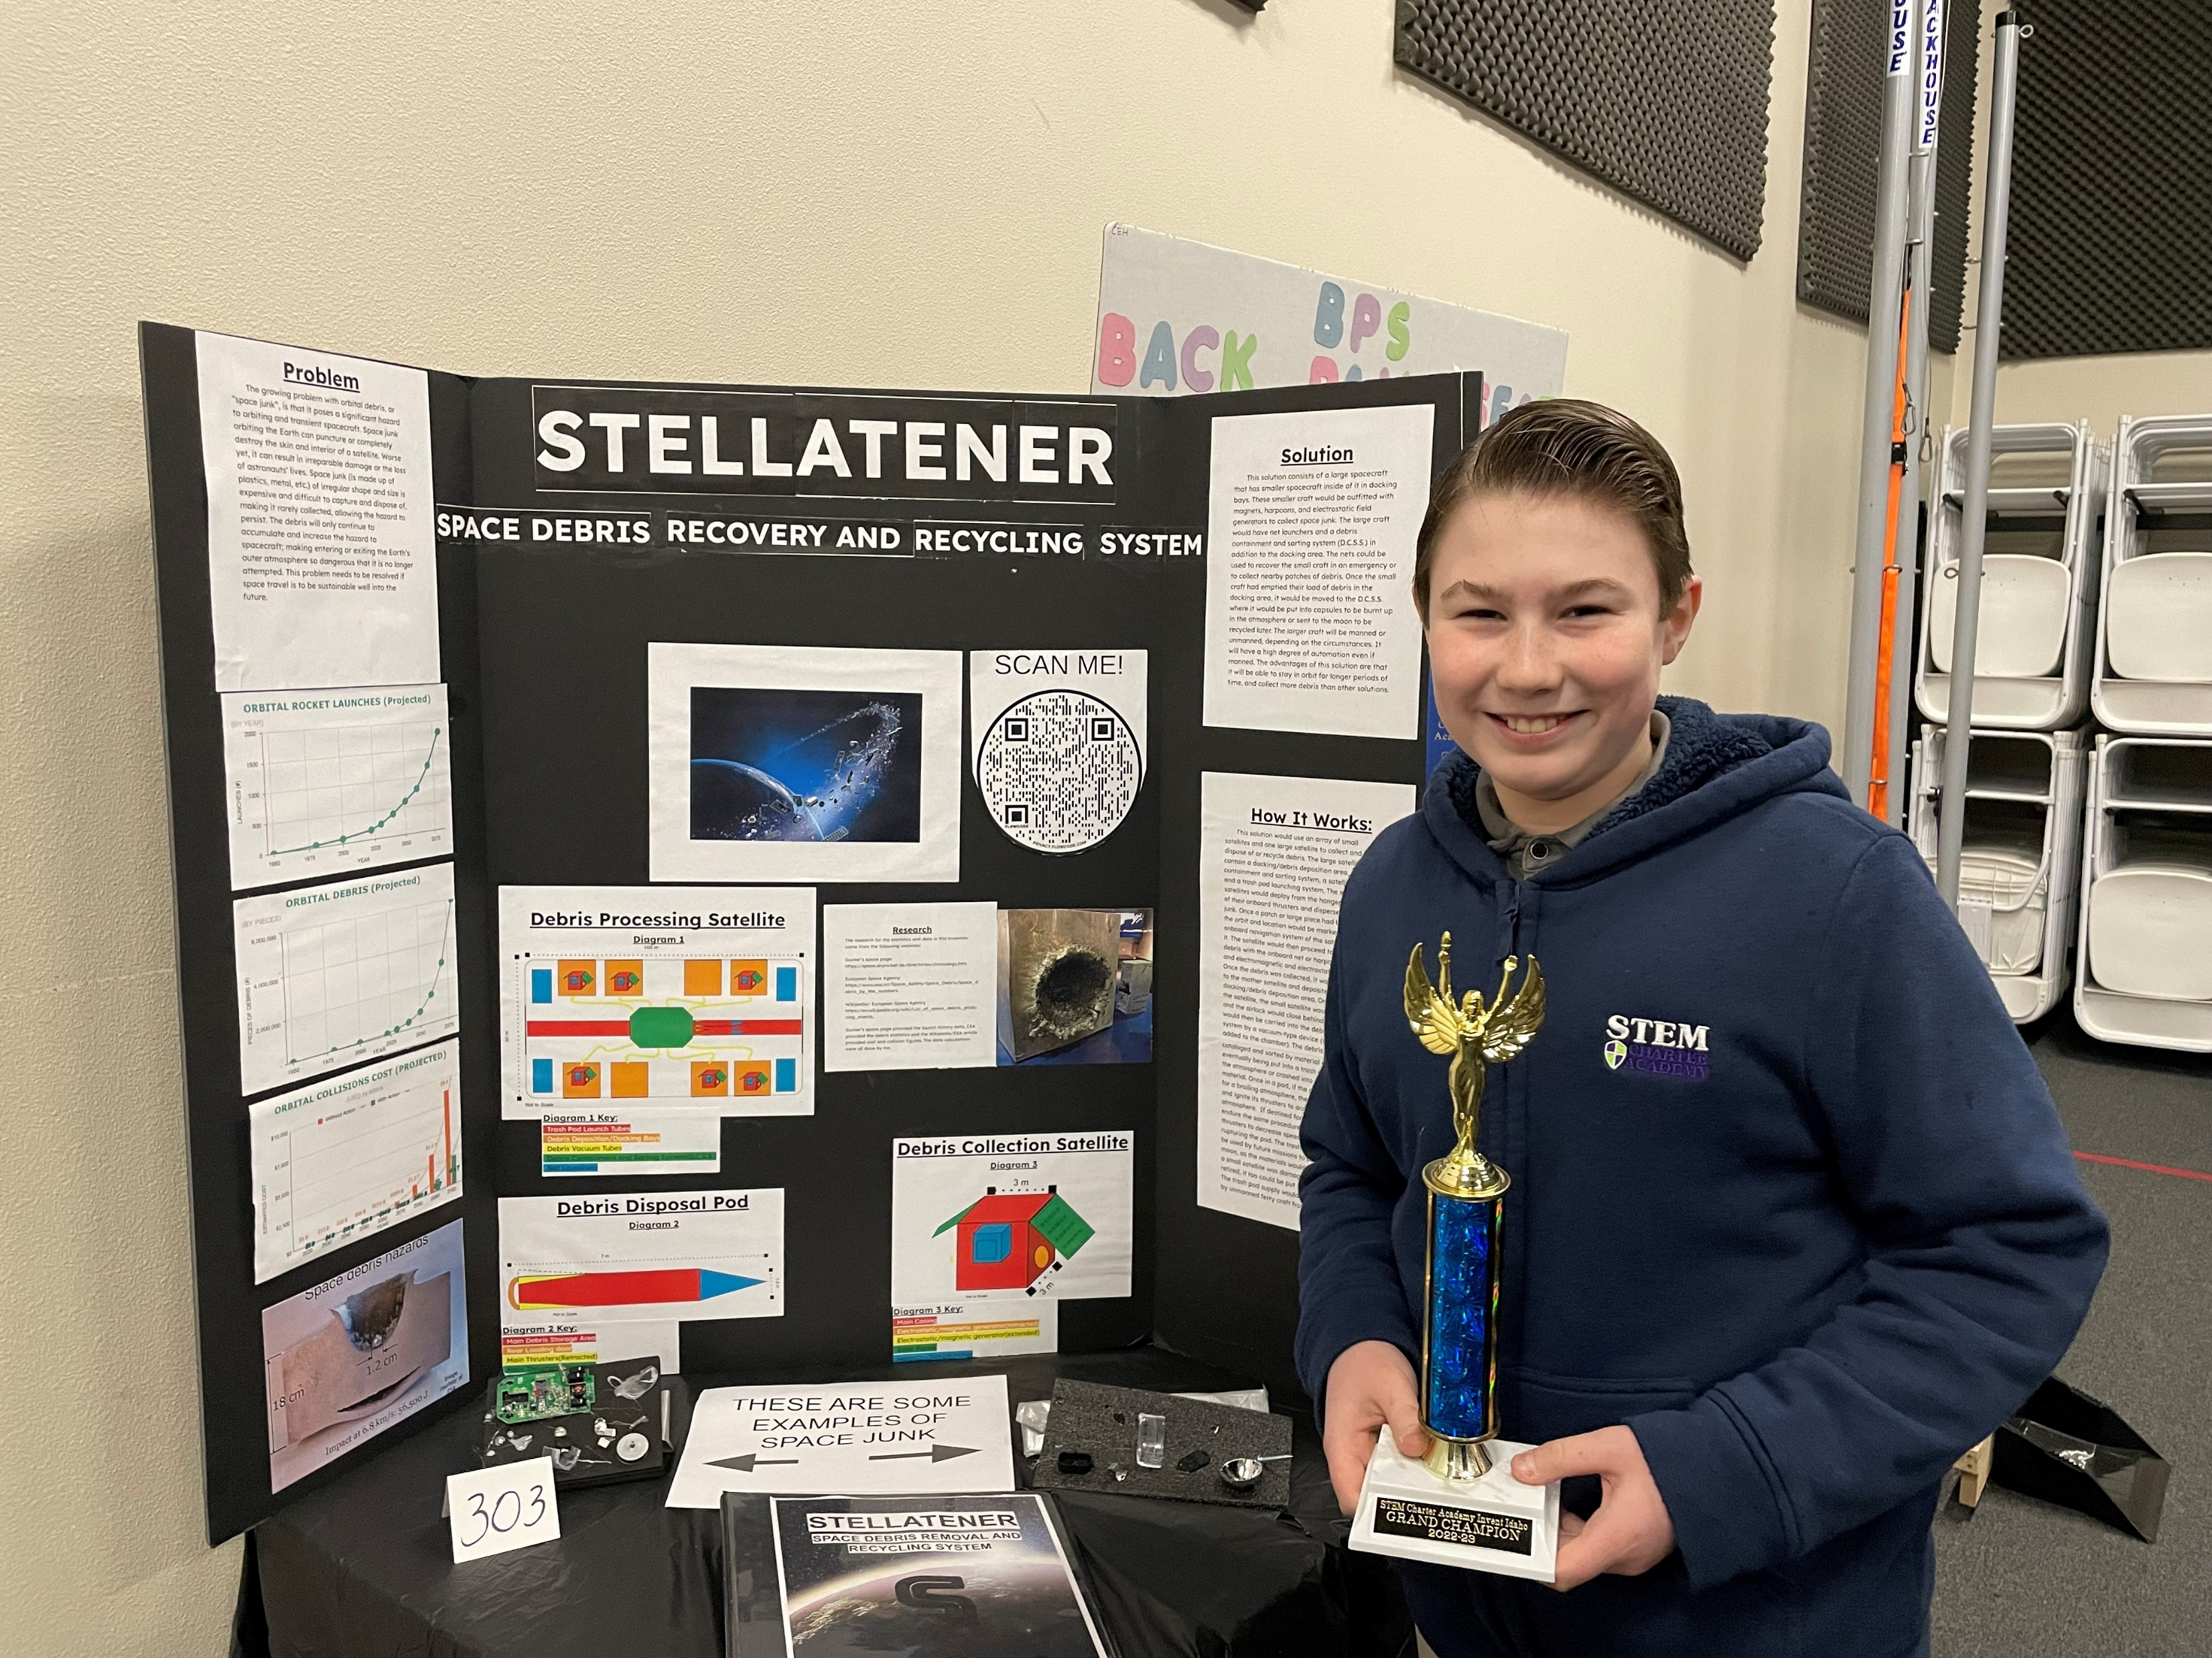
The Invent Idaho MISSION is to:
Inspire, encourage, and recognize students
for their inventions, designs, and innovations.
Free to enter
Professional Development Workshops
Invention Education
Lifelong skills

Slide 2
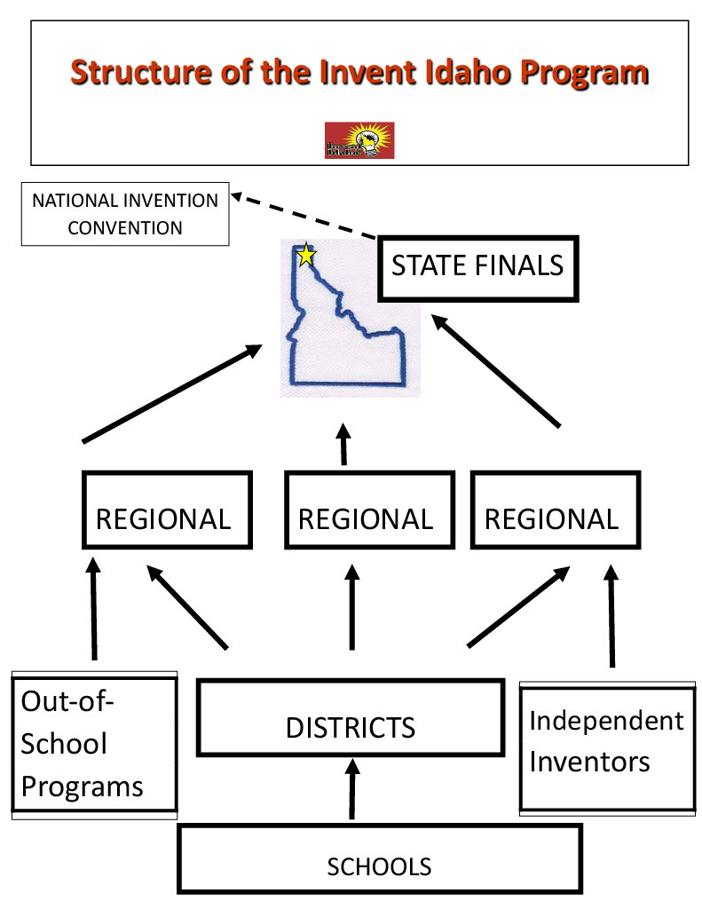

Slide 3
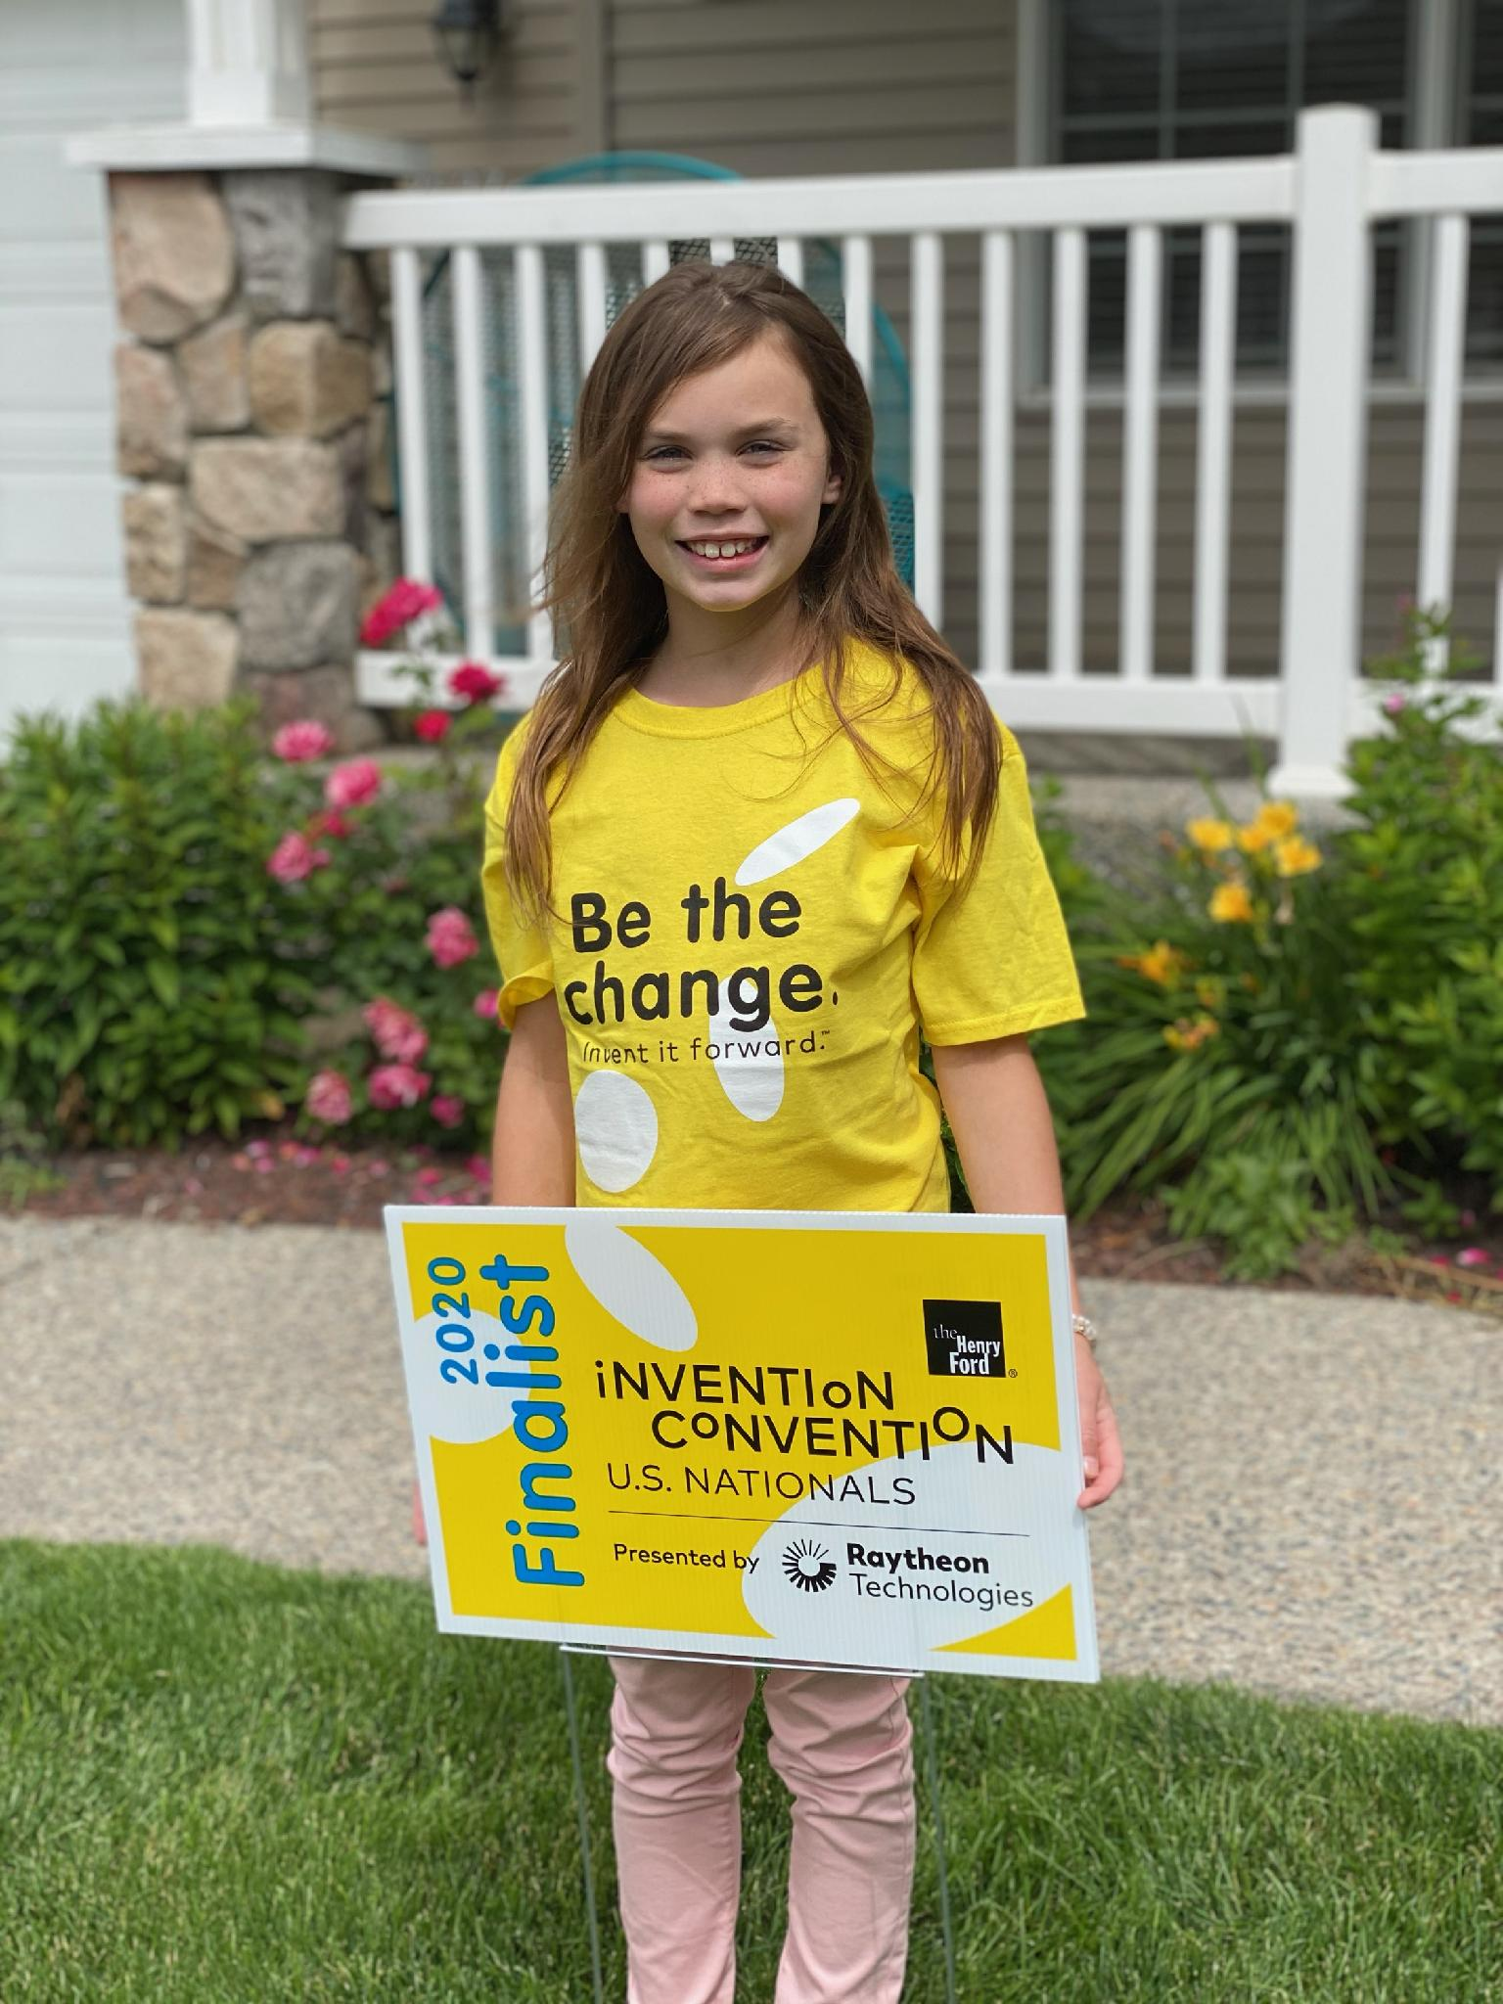
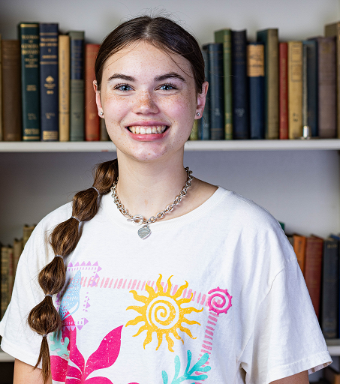
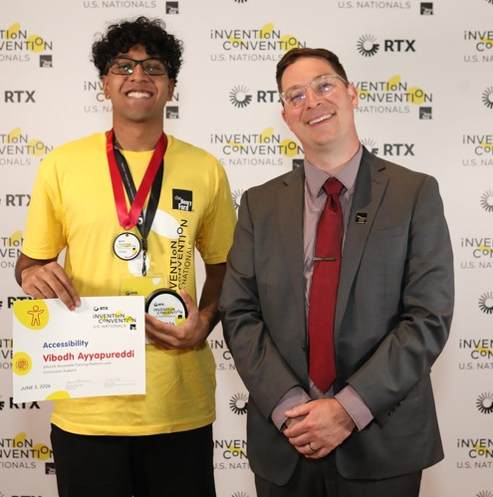
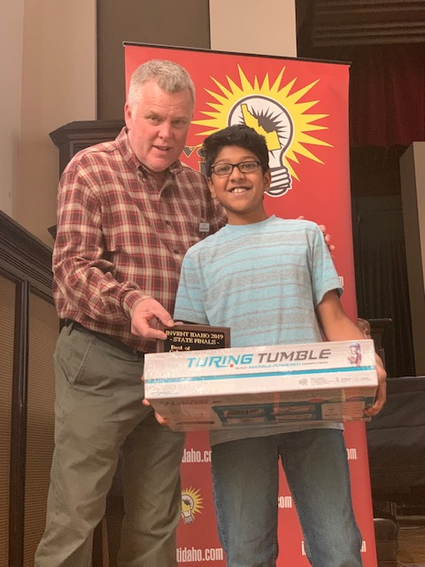
Repeat Inventors
U.S. Patent Awarded June, 2026
3rd grade
2026 National Invention Convention Global Change Award Winner
5th grade

Slide 4
Learn more and
REGISTER:
www.inventidaho.com
Contact:
Beth Brubaker bethbr@inventidaho.com
Shelley Pressley, State Director
Shelley.pressley@gmail.com
Or your Regional Coordinator

