Slide 1
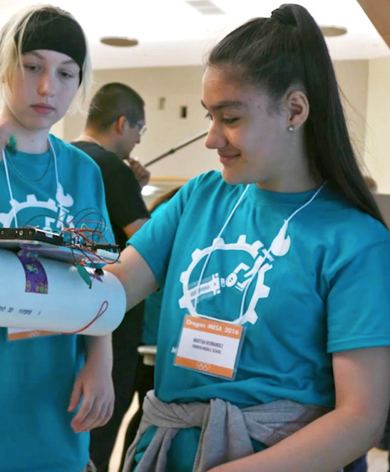



Creating the Next Generation of Problem Solvers
Katie Krummeck
Program Officer
Notes:
Good morning!

Slide 2

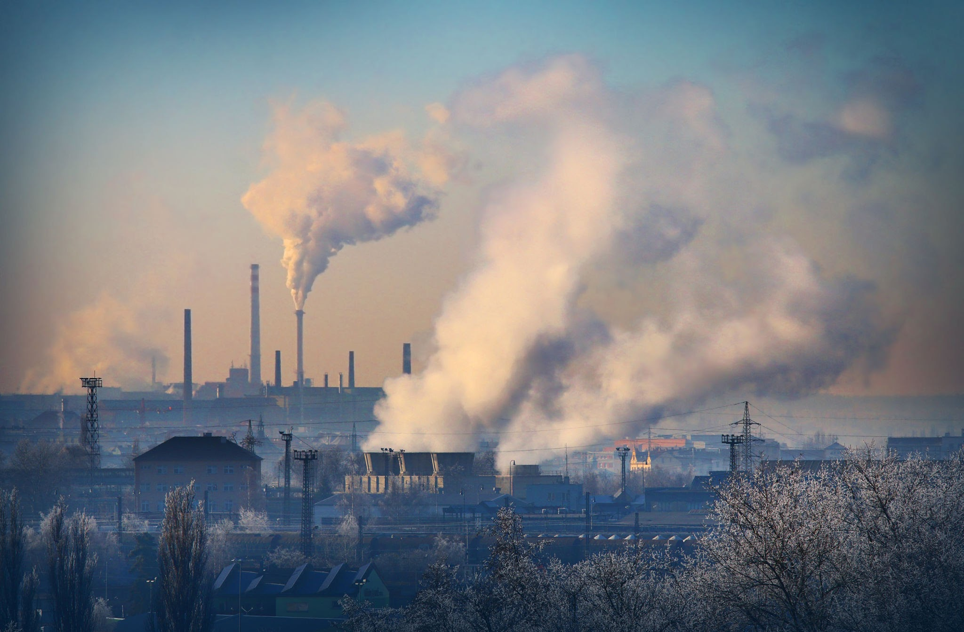



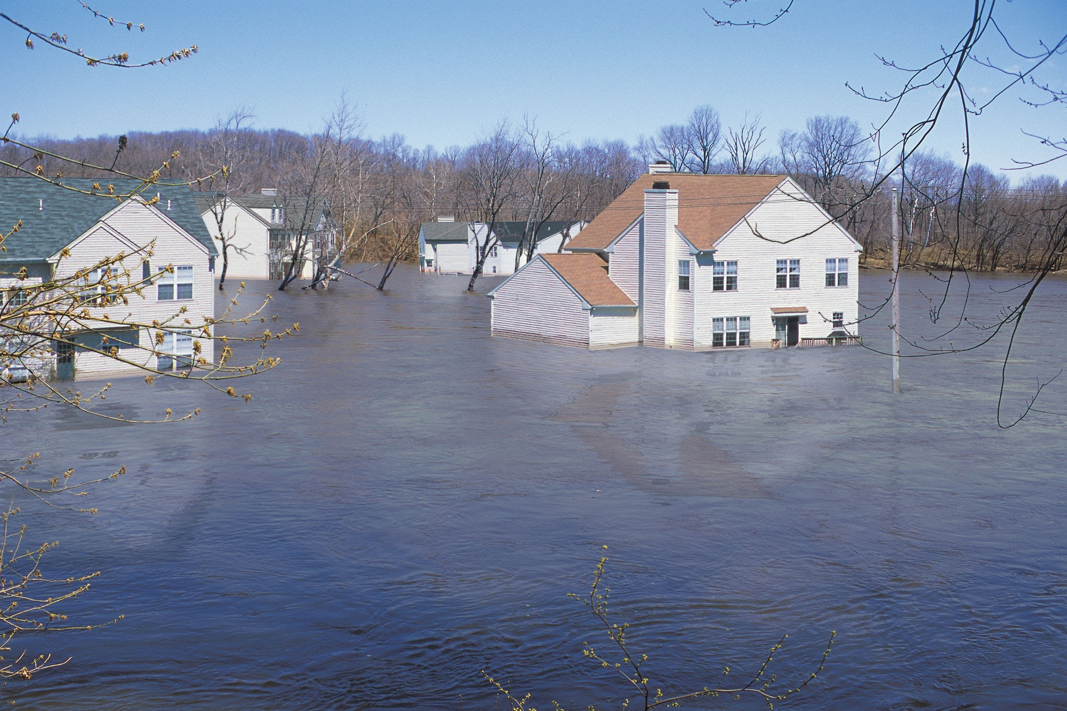
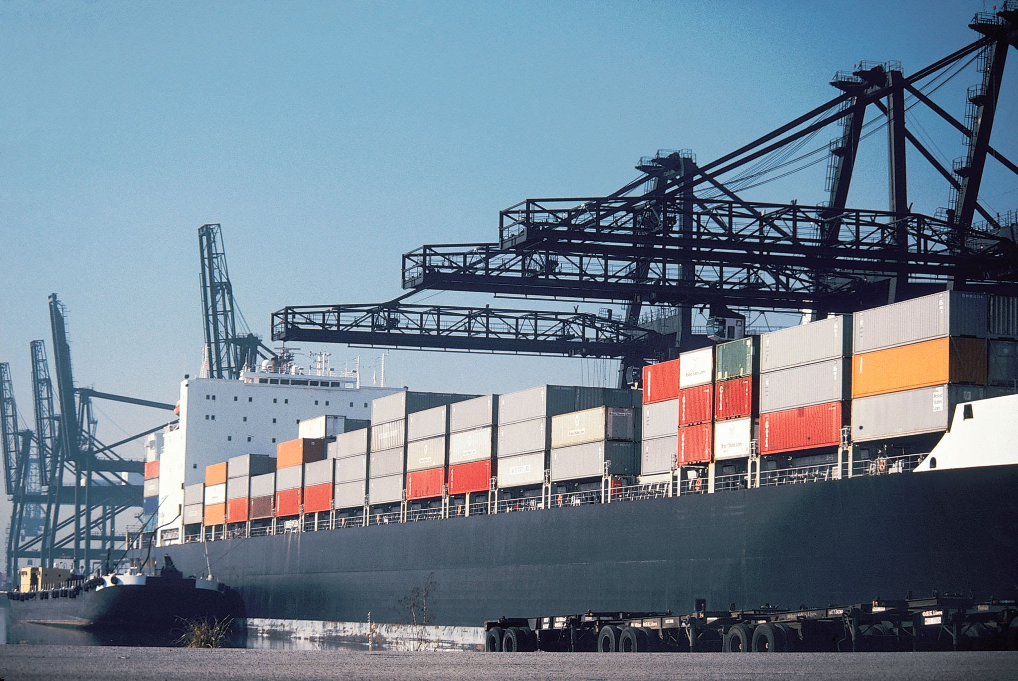

Slide 3
So.

Slide 4
So. Many.

Slide 5
So. Many. Problems.

Slide 6
What do problems call for?

Slide 7
At the Lemelson Foundation, we believe that sustainable and ethical inventions and innovations are the key to addressing the economic and environmental challenges of our time.

Slide 8
And, we believe that education is the key to developing and nurturing the next generation of inventive, ethical, courageous problem-solvers and change-makers.

Slide 9
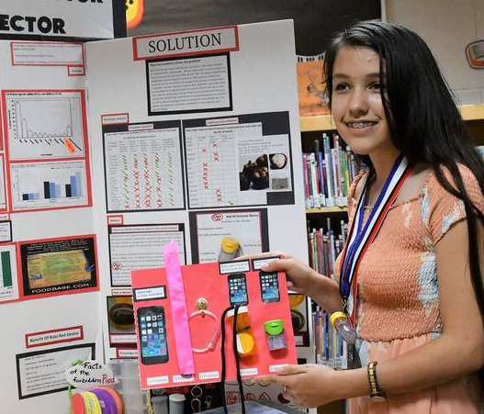
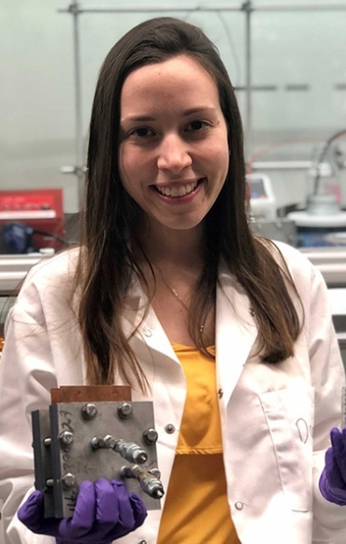
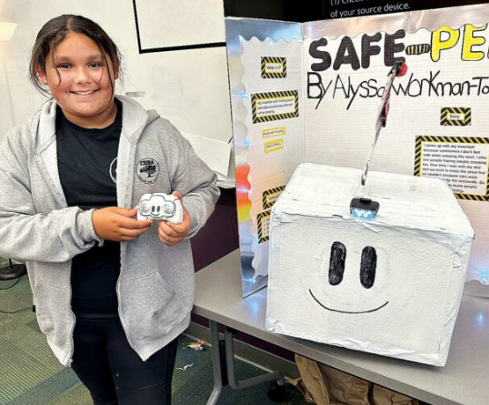
Invention Education
Invention education is a student-centered educational approach through which learners identify real-world problems and draw upon a range of disciplines to design, prototype, test, and refine inventive solutions that create meaningful value for their communities.
Notes:
The Lemelson Foundation has been investing in research and models to examine what real-world learning looks like, through invention education.
Simply put, invention education is students identifying problems they care about and utilizing the invention process to solve them.
For example:
Alyssa in the 5th grade created a remote-controlled robot to serve as a crossing guard to combat injuries young people were having getting to school.
13-year-old Jianna from Michigan invented a device to detect Red-30, which she is deathly allergic to.
Daniela Blanco of New York University, invented a more sustainable nylon production model. Nylon is everywhere in the clothing we wear. She worked to reduce waster in energy and materials and reduce carbon emissions.
When we allow people to choose problems they care about, they dream big and they develop skills to make them a reality.

Slide 10
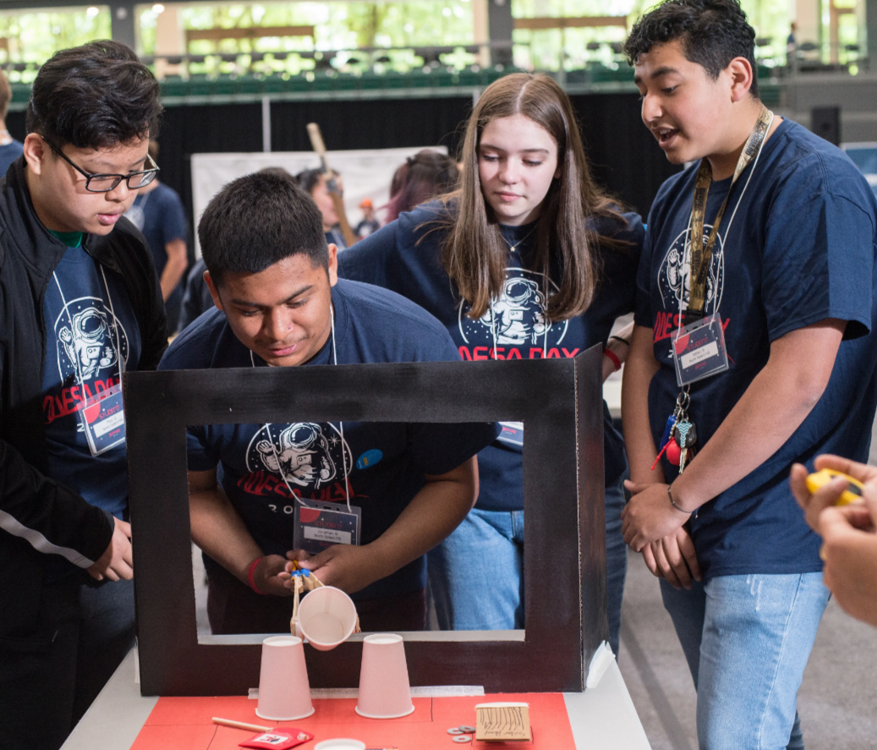
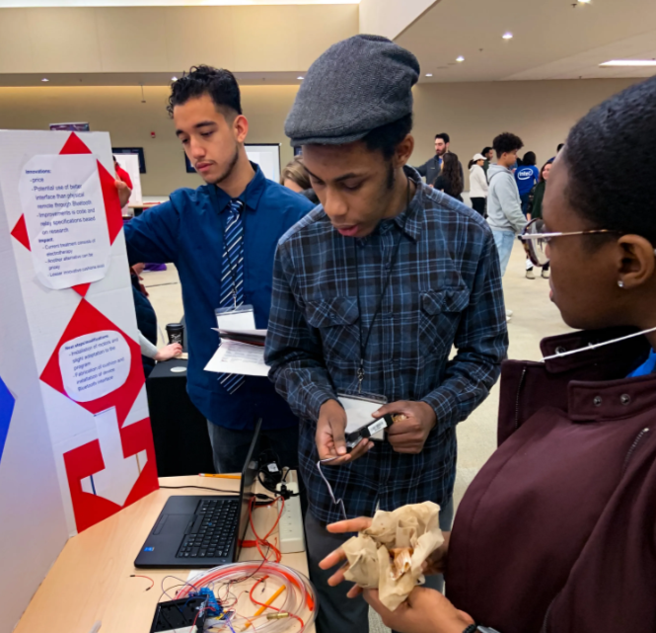
Common Elements of Invention Education Experiences
A problem-finding or defining stage
Open-ended inquiry to solve real-world problems
Teamwork and collaboration within and beyond the team
Mentors and others from the larger community
Iterative and recursive learning and design cycles
Embracing learning from failure and navigating uncertainty
Educators as guides, mentors, or coaches who learn alongside students
Notes:
Invention education is way of teaching and learning. There are many models across the country who are doing this effectively.
When we look across the invention education ecosystem we notice the following:
A problem-finding or defining stage (Young people find problems they care about)
Open-ended inquiry to solve real-world problems (There isn’t a right or wrong answer)
Teamwork and collaboration within and beyond the team (Students learn how to work with others)
Mentors and others from the larger community (There’s engagement from other learning providers – educators do not have to know everything)
Iterative and recursive learning and design cycles (Students continue to redesign based on data and feedback)
Embracing learning from failure and uncertainty (Students learn to fail faster to succeed sooner)
Educators as guides, mentors, or coaches who learn alongside students (Educators take a back seat to teaching and let young people do the learning)
I have colleagues in the room who are delivering invention education. The Henry Ford, Smithsonian’s Spark!Lab, and VentureWell are here. I encourage you to speak to them to learn more about their delivery model. There are many more both in the US and in other parts of the world.

Slide 11
Educators’ Reasons for Engaging in Invention Education
Connecting students to real world experiences and authentic community-based problem-solving
Supporting students to integrate and apply knowledge
Building excitement, engagement and ownership in students
Providing students with the opportunity to build durable skills and mindsets as well as confidence and self-efficacy
Focusing on the process of learning, the process of problem-solving and the process of trying, failing and trying again
Notes:
We are seeing more excitement from educators to teach – and I can vouch for these findings as I used to teach invention education -
We see students are excited to solve problems they care about
We love seeing students being curious and asking them questions, now we can help guide students to more learning
Students and teachers get to connect to their community – whether it’s solving a problem their community needs or finding someone with a skill they need to learn from

Slide 12
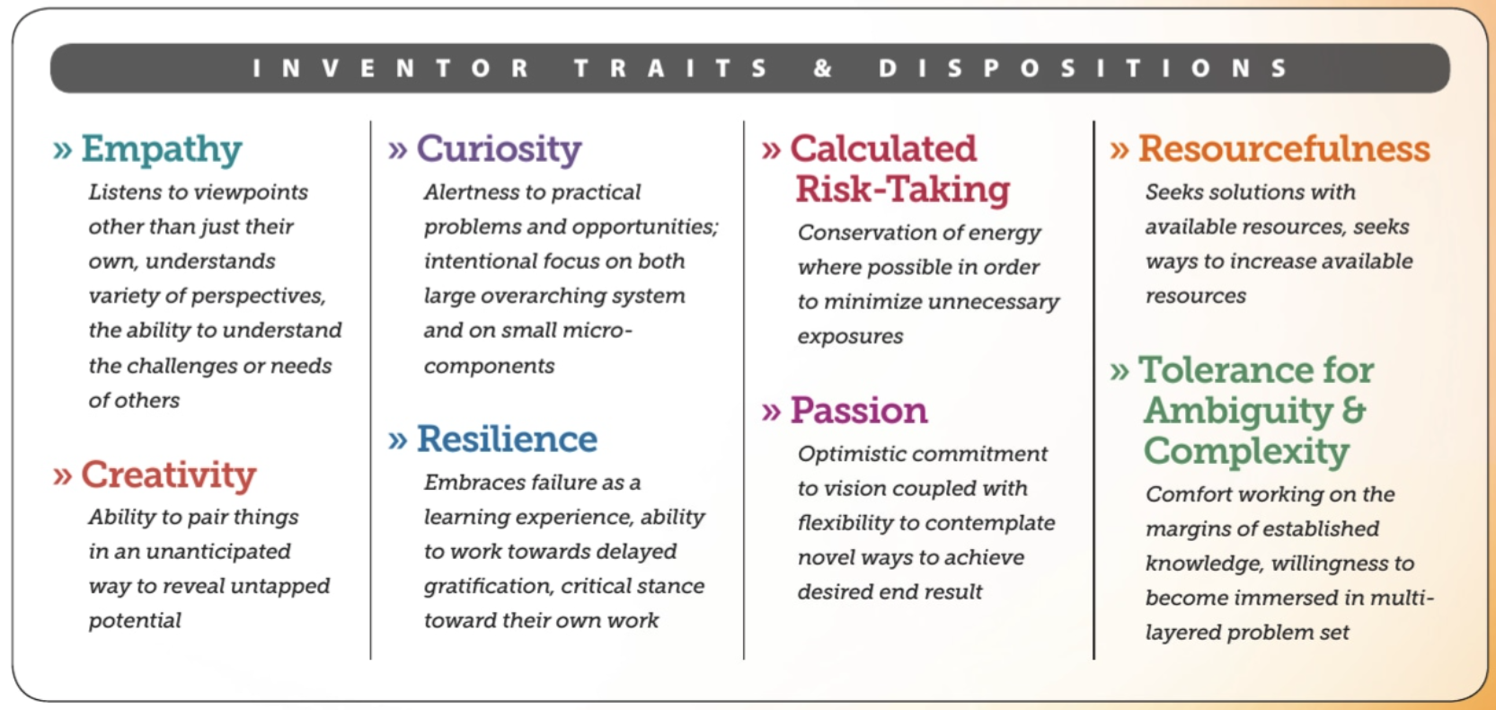
Source: Framework for Invention Education, 2020

Slide 13

How does Invention Education prepare students thrive in the future?
“Education in the 21st century must go beyond imparting knowledge; it must cultivate the skills and mindsets needed to solve complex, interdisciplinary problems. Key competencies for the future include:
Critical thinking and creativity: The ability to analyze problems from multiple perspectives and develop innovative solutions.
Collaboration and communication: Skills to work effectively in diverse teams and articulate ideas clearly.
Ethical and global awareness: Understanding the interconnectedness of global challenges and the importance of equity and sustainability.
At the heart of this transformation is the imperative to develop not only capable professionals but also good citizens and ethical human beings. A critical socio-humanistic education remains essential for nurturing individuals who can contribute to a just and empathetic society...”
Source: Education can help prepare learners for tomorrow’s demands | World Economic Forum, Jan 2025

Slide 14
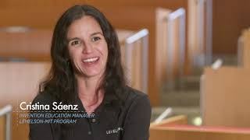

Slide 15
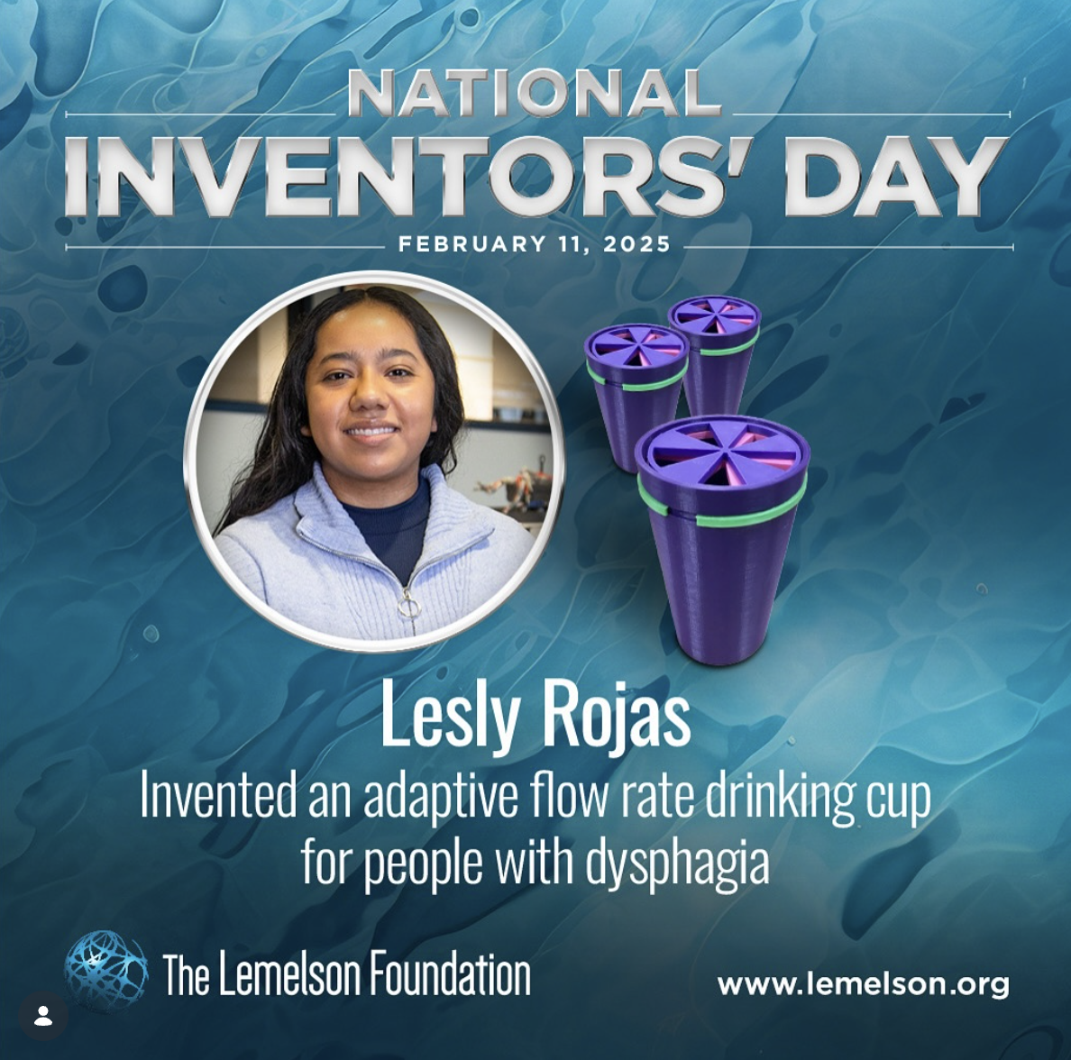
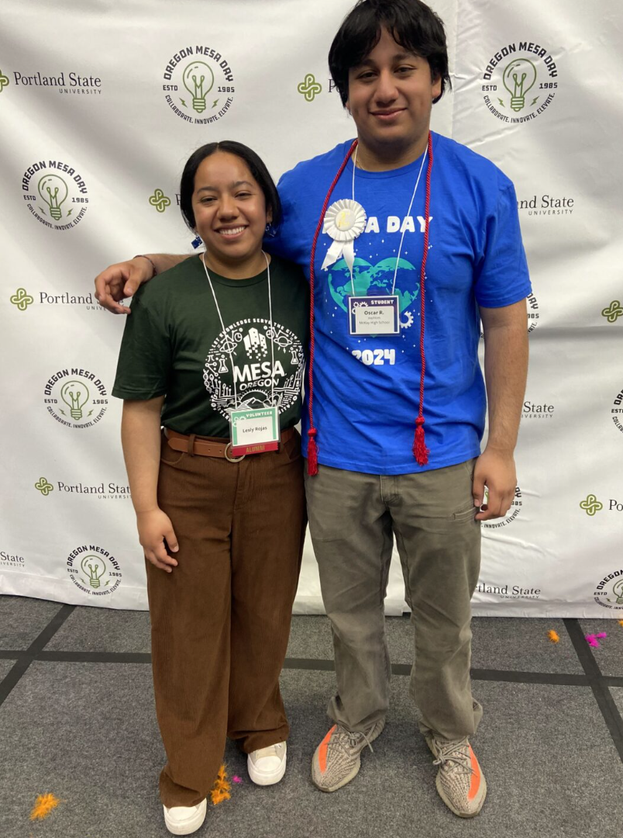

Slide 16
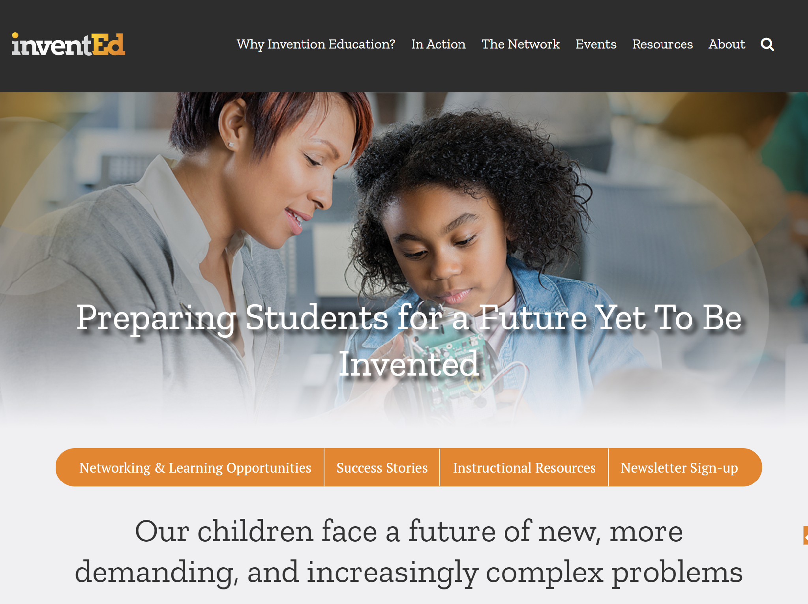

Join Us to Help Build this Field of Teaching & Learning
The InventEd Network is a coalition of K-12 educators, nonprofit leaders, researchers, government agencies, funders, and others who are building and supporting the field of invention education. We commit to the power of collective action to bring invention education to all students.
www.inventioneducation.org
Notes:
Finally, I hope you will join me and my many colleagues across the country to continue building effective models and practices in invention education. InventEd was formed to unite various actors in helping to continue to build the field of invention education and advocate for it so every child has the right to be a future problem solver and have agency in choosing where they do it. Anyone can join us.
To learn more about this work, I hope you will visit us at inventioneducation.org where you will find frameworks, research and more.
Thank you for listening.

Slide 17
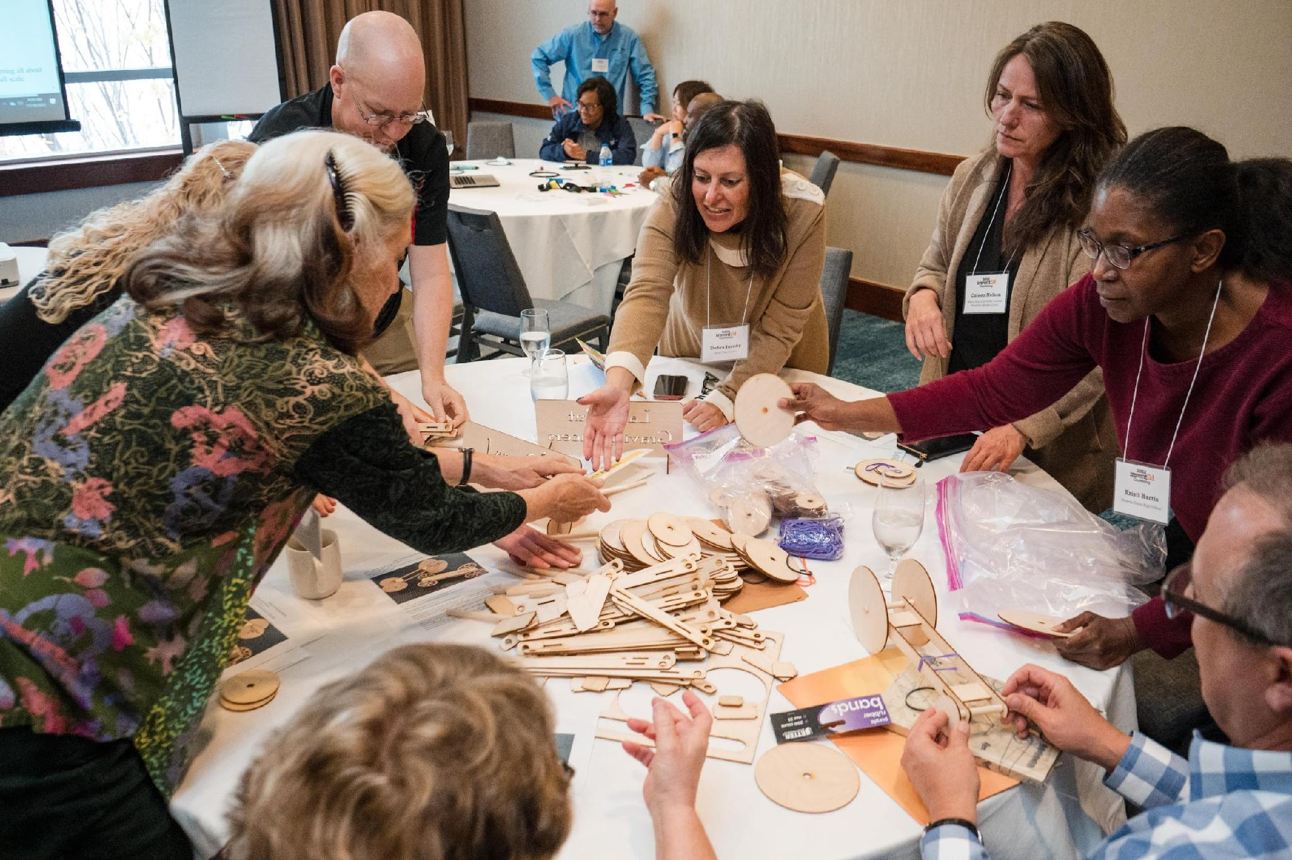
Explore invention education!
There are many other K-12 educators like you who are part of an invention education community of practice!
Join the InventEd network to connect with other educators, extended learning programs, researchers, and other advocates who are building the field of invention education.
We share resources and progress, work together to reach more students, and build awareness and understanding of invention education.
Re-invigorate your teaching practice through informal mentorship, peer support and professional development.
Notes:
We focus on supporting learning and sharing through a community of practice, building awareness around invention education’s value, and developing an ecosystem of partners who are interested in invention education and want to integrate it into their programs and work.
Inventioneducation.org: Go there to explore curricula offerings, programs, and stories like Dasia’s about how invention education impacts student learning

Slide 18
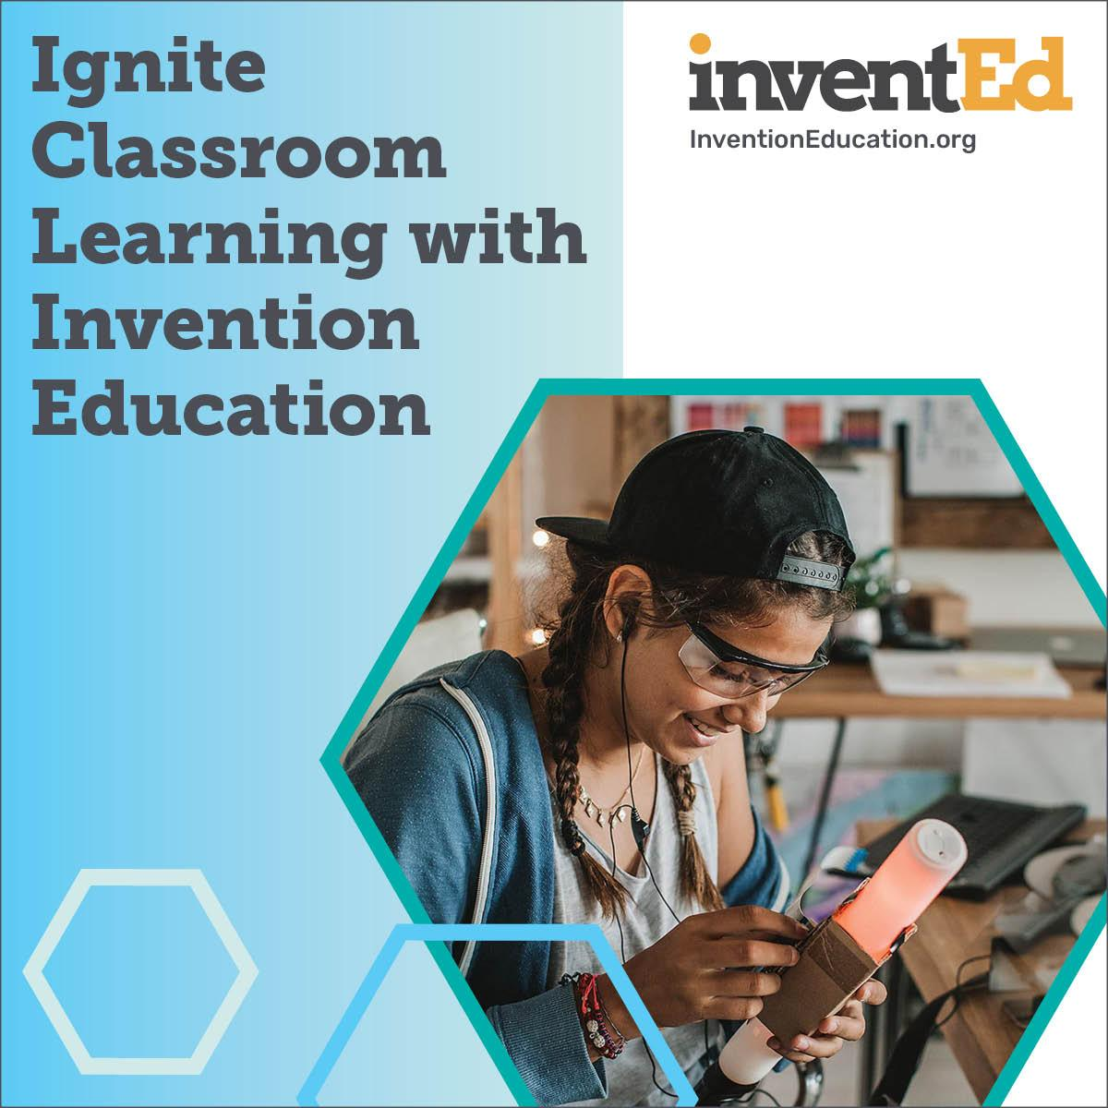
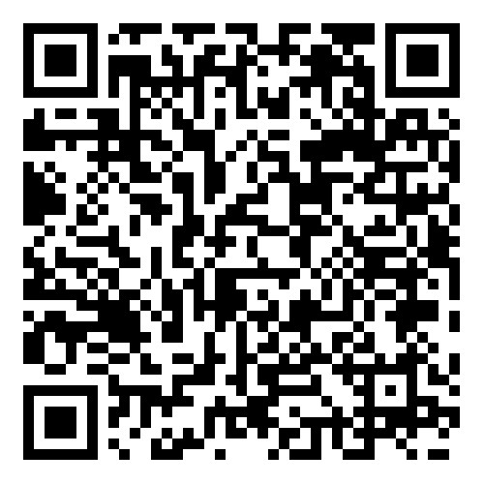

Start sharing what you’ve learned
Share what you’ve learned with peers and administrators!
New community-informed one-pagers and “get started” toolkit to help you integrate invention education into your classroom and programs.
Reviewed and approved by new and experienced teachers and administrators who are doing invention education.
Scan the QR code to access these materials!

Slide 19
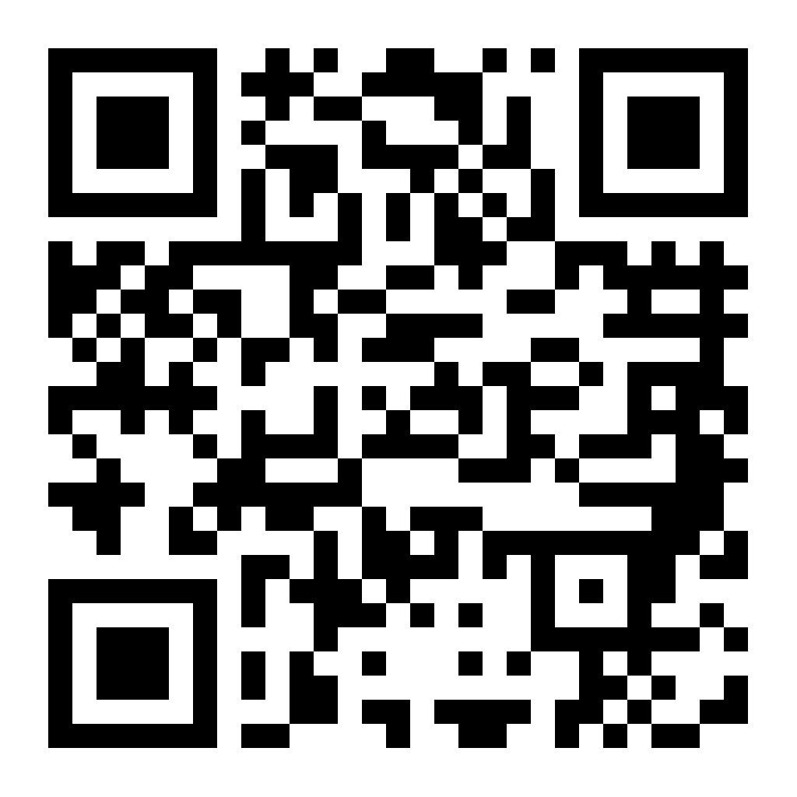
Sign up to get resources & stay connected
Explore more at: inventioneducation.org
webinars
educator, student and supporter testimonials
links to curricula and programs
and sign up to receive our newsletter!

Slide 20


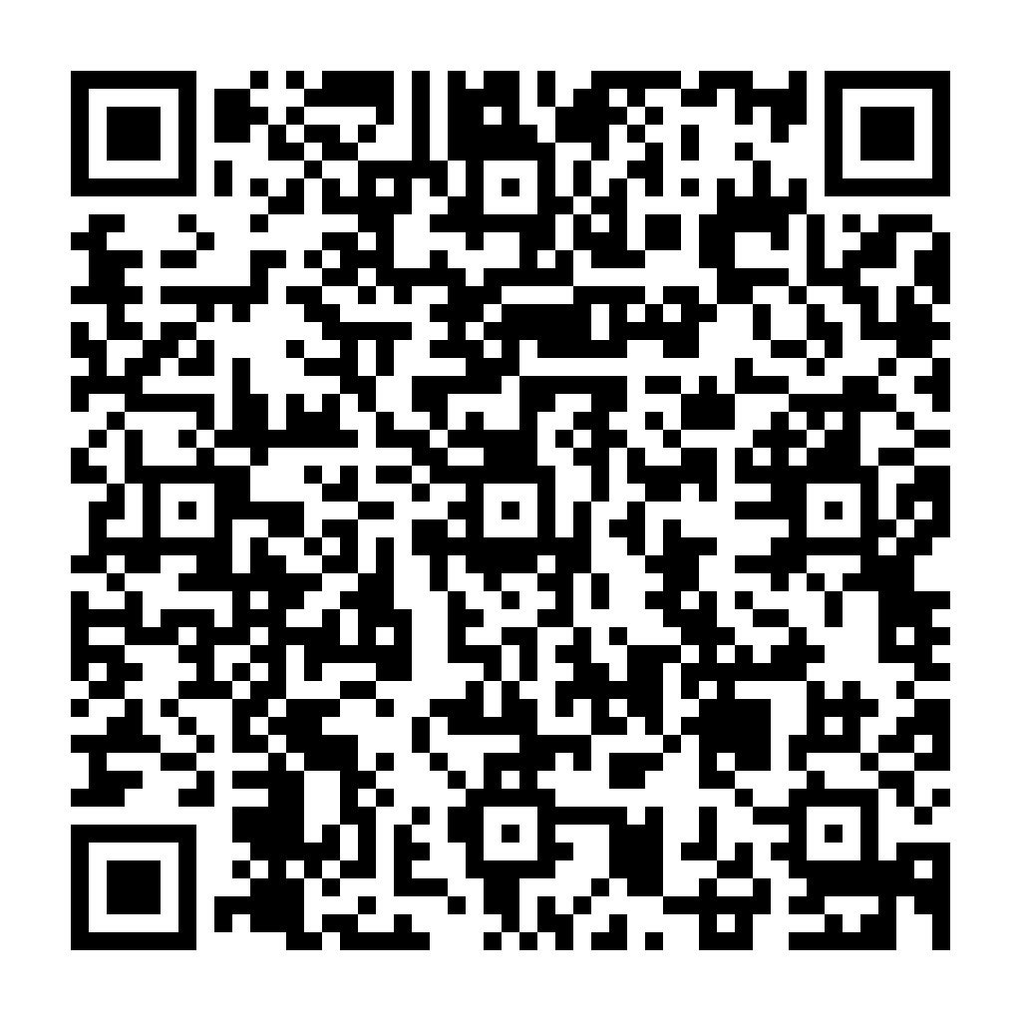
Soil & Solutions: An Invention Education Approach to Climate-Centered Learning

Slide 21
Thank you!

