Slide 1

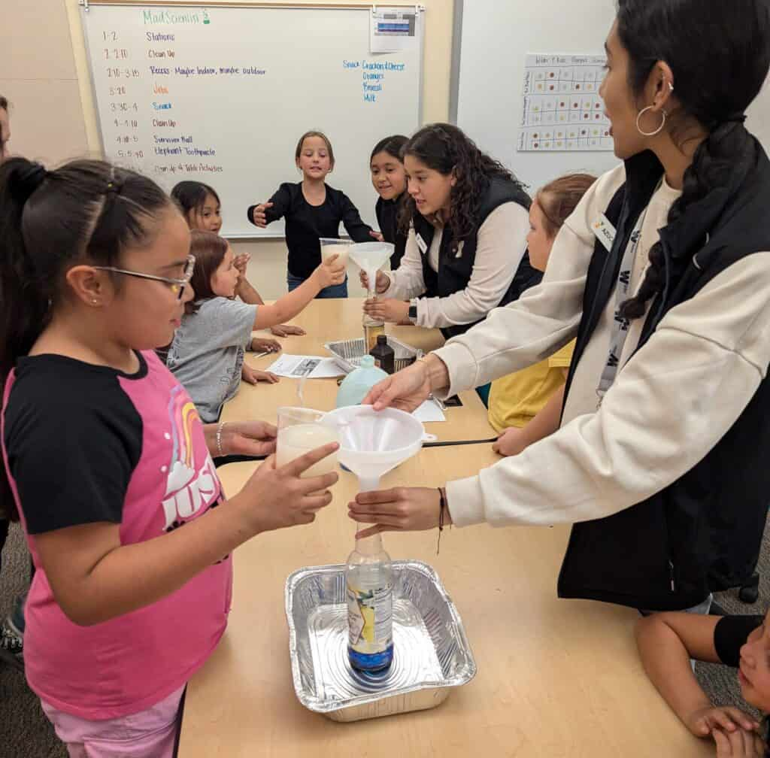
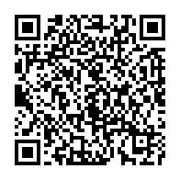


Visit the ION website for:
Free STEM Activity Guide
Contact your local TMC Lab to borrow supplies
Submit user reports
Questions?
Contact Claire Sponseller
csponseller@uidaho.edu

