Slide 1
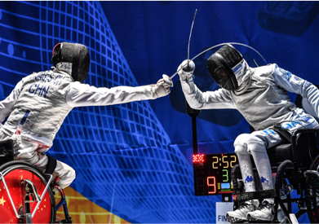
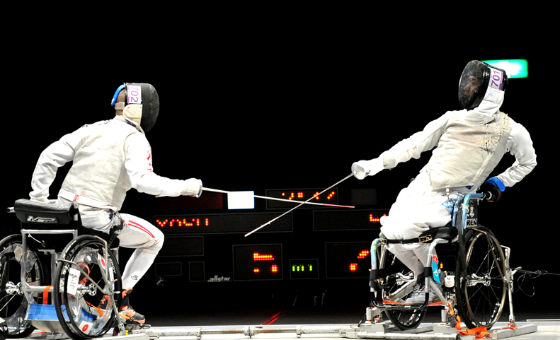


Adaptive Fencing Clinic
3/21 | Saturday, 9:00 AM-Noon.
Fort Collins Senior Center
Learn the basic techniques of the challenging and competitive sport of Paralympic fencing. This clinic will be led by Patricia Dykes, a United States Army veteran, Paralympic fencing athlete and coach who has competed all over the world. Note: Modified instruction and equipment for varying ability levels available, including equipment for those with visual and/or hearing impairments
Register at fcgov.com/recreator using Activity #202765-01
No Fee, Completely Free!
Questions? Contact Brenda McDowell at bmcdowell@fcgov.com or 970-416-2024.

