Slide 1


Skill Training
Curriculum Implementation Support Program
Dr.T.VenugopalaRao,M.D,
Faimer Fellow
Professor of Anaesthesiology & Academic Director,MIMS

Slide 2
Objectives
Teach skills effectively
Teach skills at the workplace
Use a skills lab effectively
Methods of comptency acquisition
Demonstrate learning of presctiption skills

Slide 3
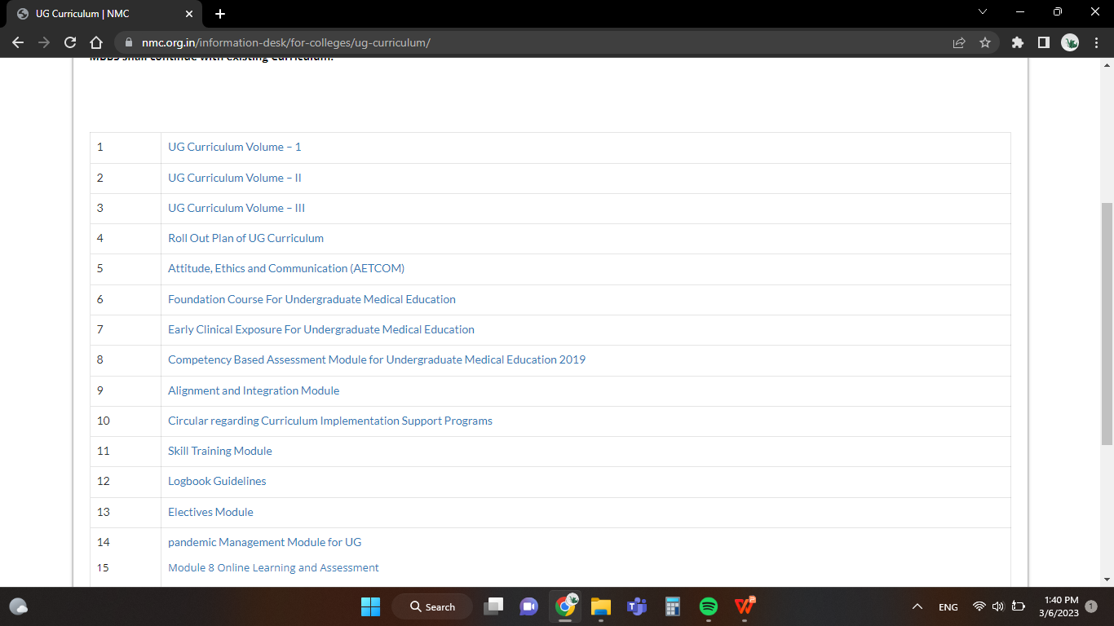

Group Activity

Slide 4
Practical and clinical Teaching
Practical - Pre clinical, paraclinical subjects, community Medicine
Lab based teaching, slides reparation,prescription writing, simulation, reflections, projects,seminar presentation,PBL etc.
Clinical subjects and community medicine
Bedside teaching, case based, reflections,projects, seminar presentation, PBL , experiential learning etc.

Slide 5
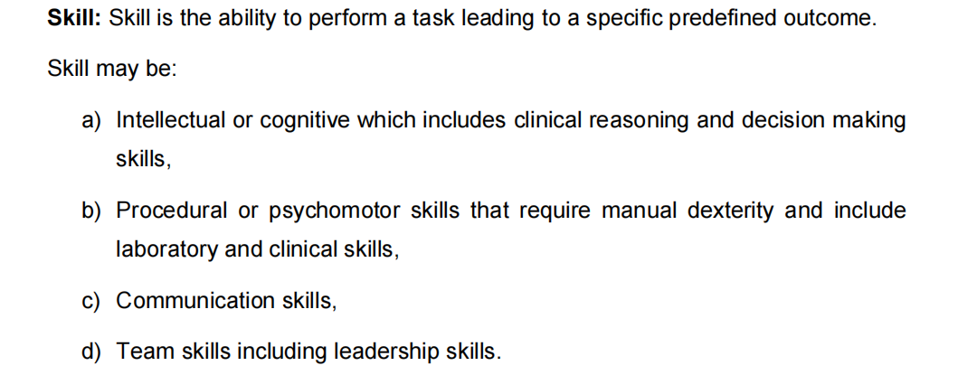
NMC module on Skills

Slide 6
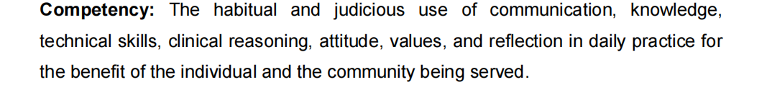
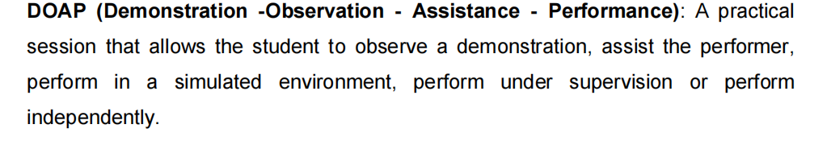
NMC module on skills

Slide 7
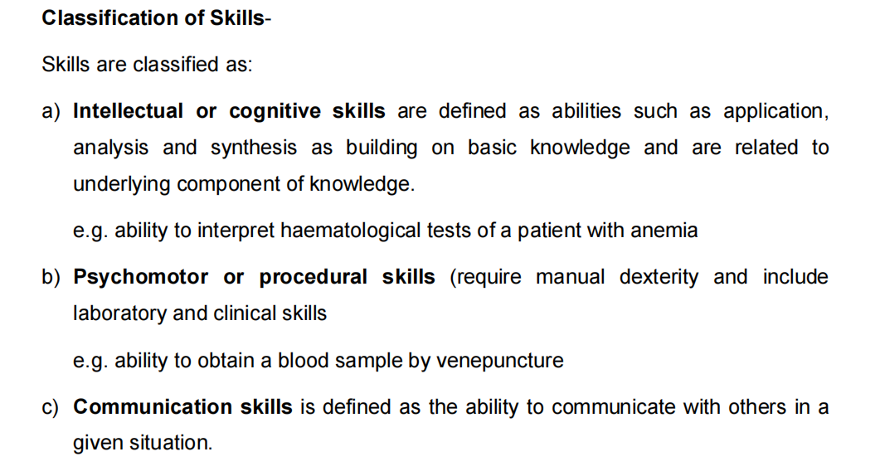
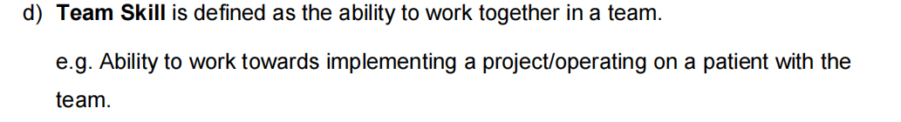
NMC module on skills

Slide 8
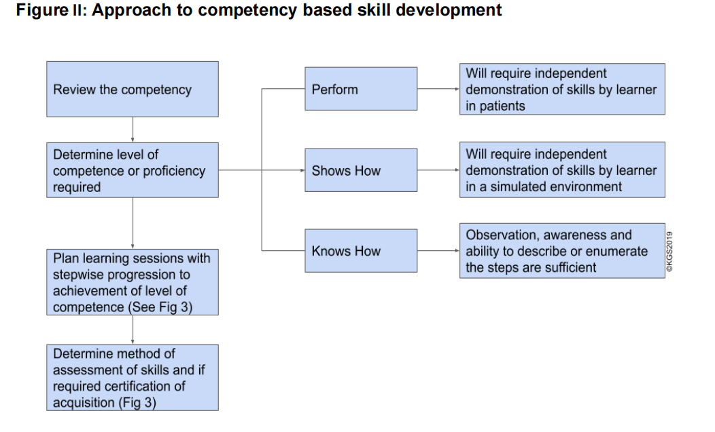
NMC module on skills

Slide 9
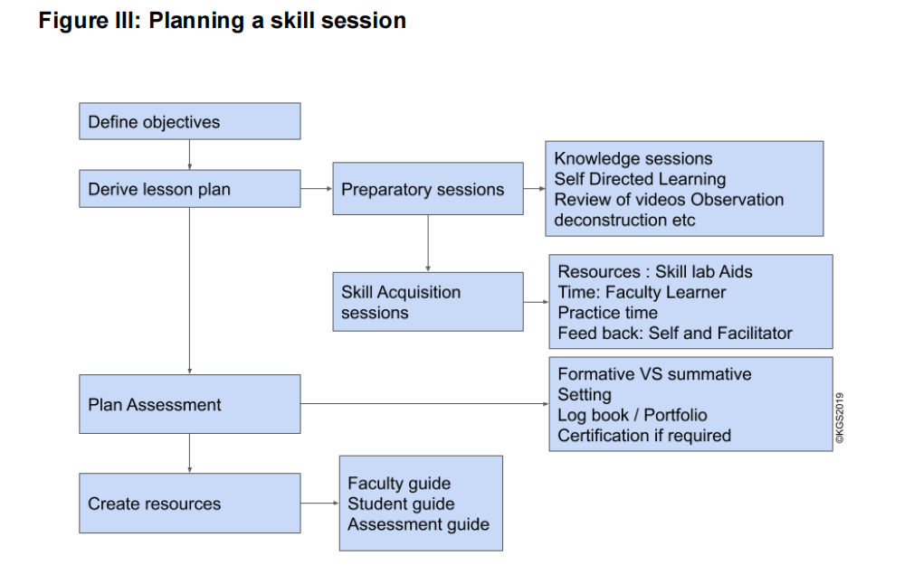
NMC module on skills

Slide 10

Stages------- log of performance
Aim of CBME is not merely competency but expertise in area
Expert/ Master
Proficient
Competent
Advanced beginner
Novice

Slide 11
I-Independently performed on patients,
O-Observed in patients or on simulations,
D-Demonstration on patients or simulations and performance under supervision in patients
Certification of Skills: Any faculty member of concerned department can certify skills. For common procedures, the certifying faculty may be decided locally.

Slide 12
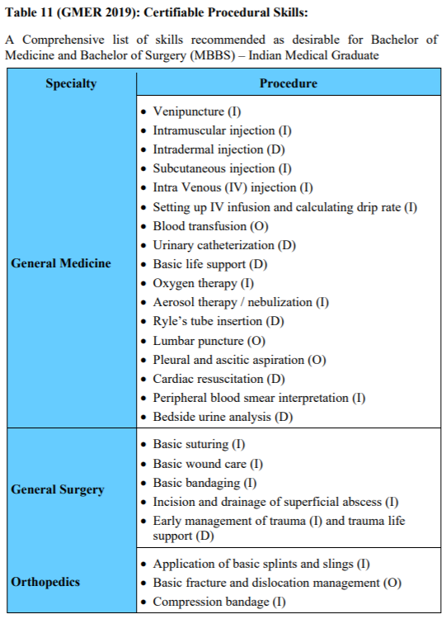
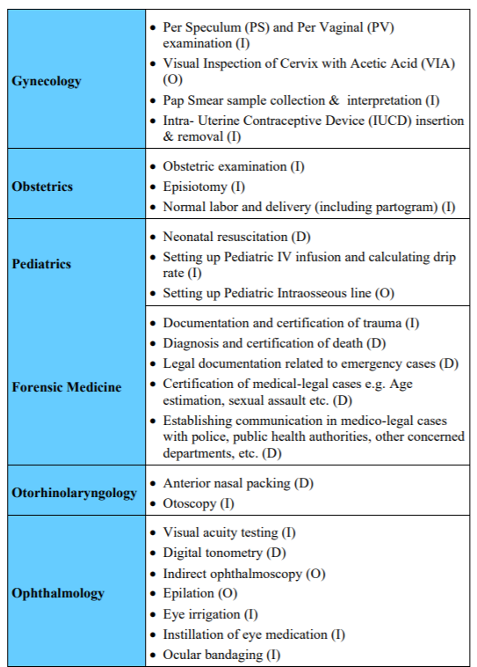

Slide 13
Teaching strategies
Clinical encounter conducted by the physician-teacher
Clinical case presentations
Case based discussions/ chart stimulated recall
Clinical problem solving exercises
Structured case presentation models
SNAPPS, One Minute Preceptor

Slide 14
Teaching intellectual skills
Physician-teacher (for demonstration), or preferably by the student observing a clinical encounter.
Clinical case presentations, case based discussions/chart stimulated recall, clinical problem solving exercises and
NMC module on skills

Slide 15
Teaching intellectual skills
structured case presentation models like SNAPPS (Summarising, Narrowing the differential, Analyzing the differential
Probing the preceptor, Planning the management & Self-directed earning) and
One Minute Preceptor, Reflection and metacognition
NMC module on skills

Slide 16
Teaching communication skills
AETCOM module
Communication Skill lab
Group activity for AETCOM module III MBBS part II competencies.

Slide 17

Simulated or Standardized Patients
Communication skills
Feedback from simulated patient
Patient emotions
SPSQ

Slide 18
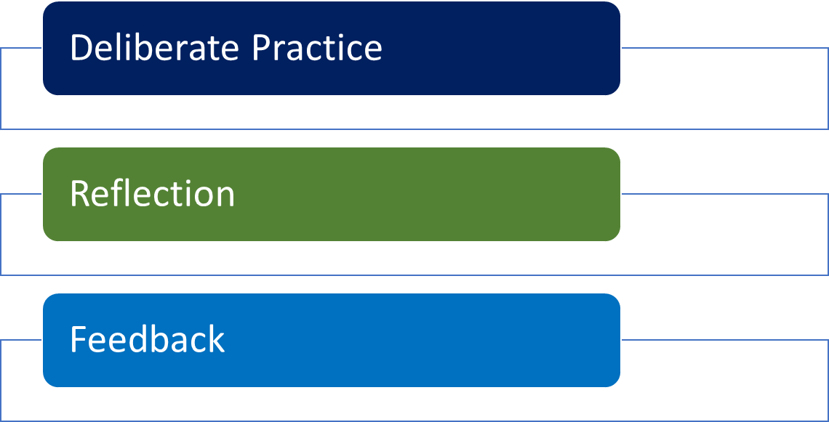
Simulation Based Learning
Artificial representation of a real situation
Replicates clinical scenarios
Achieves educational goals through
“Experiential Learning”
“Immersive” in nature
Interactive

Slide 19
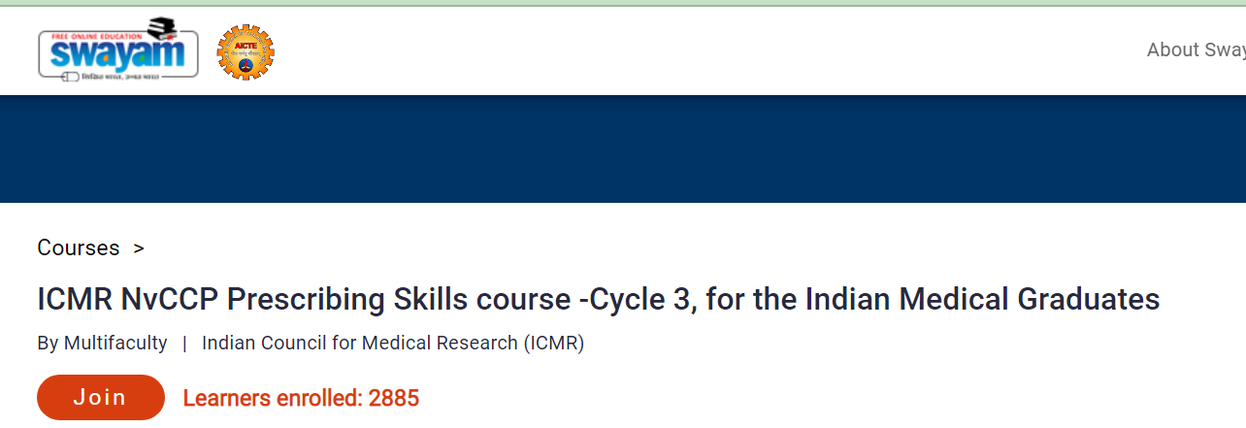
Prescription writing/ evaluation
Training programs
Modules IMG at national level ICMR
Audits

Slide 20
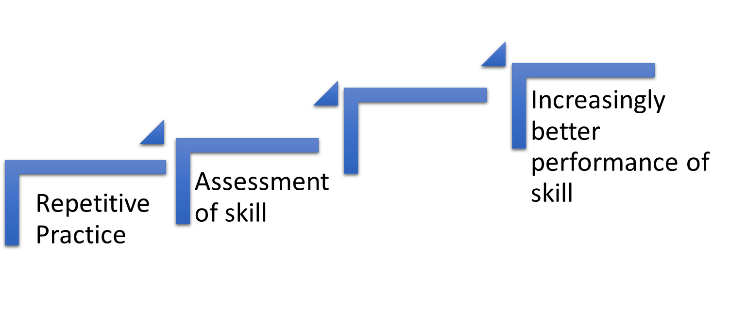
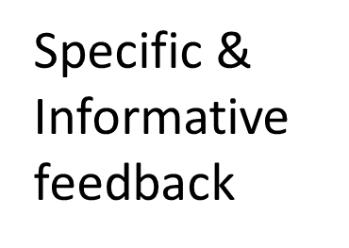
Delibrate Practice
Ericsson

Slide 21
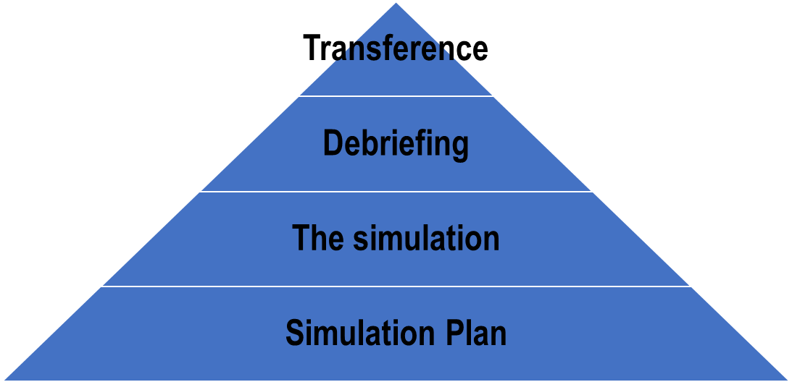
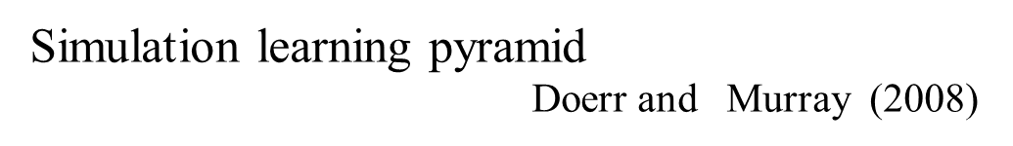

Slide 22
Demonstrate-3 groups
Resource faculty plans 3 sessions
Participants in 3 groups rotate to 3 stations-10 min each demo
Demo 1: Phase 3 MBBS Medicine skills-Intellectual skill
Group 2: Phase 3 MBBS Surgery skills-Psychomotor-simulation based
Group 3: Phase 3MBBS/internship-Communication skill

Slide 23
Large group discussion
10 min each group
Faculty facilitators notes down the important points in white board or flip chart.

Slide 24
Teaching psychomotor skill -Peyton’s Four-Step Approach
1. The trainer demonstrates the skill in real time without giving instructions or explanatory words (“Demonstration”).
2. The trainer repeats the procedure, this time describing all necessary sub-steps (“Deconstruction”).
NMC module on skills

Slide 25
Teaching psychomotor skill -Peyton’s Four-Step Approach
3. The trainer performs the skill for a third time, this time following the sub-steps only as described to him by the trainee (“Comprehension”). the most important step
4. The trainee performs the skill on his/her own (“Performance”).
NMC module on skills

Slide 26
Teaching psychomotor skill-Peyton’s Four-Step Approach
Demonstration of this method to all participants during the workshop
feedback from the participants

Slide 27
Teaching psychomotor skill
When psychomotor skills training require/ necessitate exposure to body fluids or biological hazardous materials, students must be trained on the infection control / biosafety requirements beforehand.
Procedures involving dangerous steps like mouth pipetting should be avoided or replaced with suitable other technologies / methods like bulb suction or vacuum aspiration etc. Use of non-hazardous materials must be encouraged
NMC module on skills

Slide 28
Kalamazoo Declaration - Essential elements communication list
Build A Relationship
Open The Discussion
Gather Information
Makoul G. Essential elements of communication in medical encounters: the Kalamazoo consensus statement. Acad Med. 2001 Apr;76(4):390-3

Slide 29
Kalamazoo Declaration - Essential elements communication list
Understand The Patient’s Perspective
Share Information
Reach Agreement On Problems And Plans
Provide Closure
Makoul G. Essential elements of communication in medical encounters: the Kalamazoo consensus statement. Acad Med. 2001 Apr;76(4):390-3

Slide 30
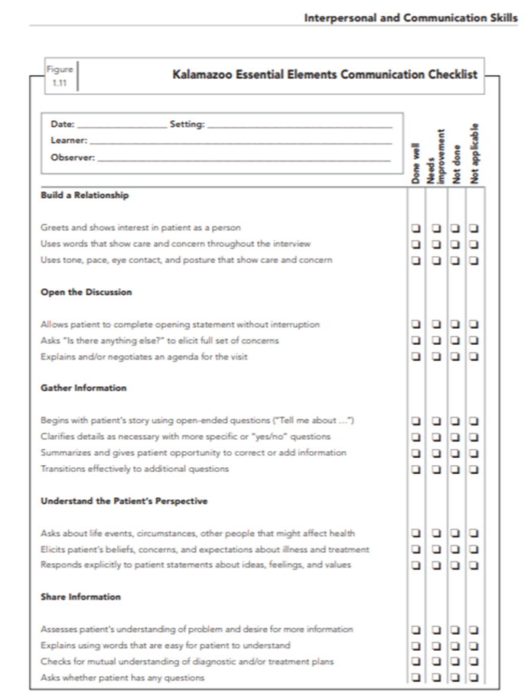
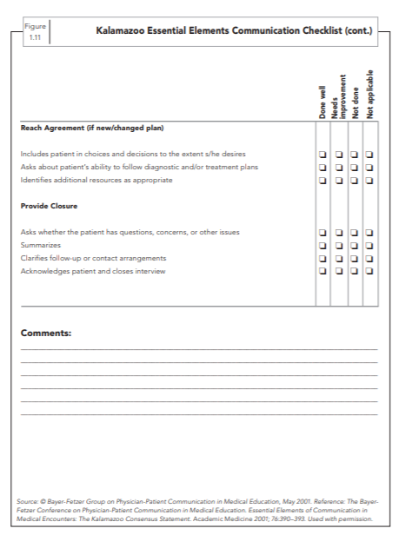

Slide 31
Gap -Kalamazoo Communication SKills assessment form
Provides scores for each aspect of communication
Strengths and areas of improvement
Clinician/Faculty, Patient/family, Peer facilitator, Self assessment

Slide 32
Gap -Kalamazoo Communication SKills assessment form
Contains Likert scale shifted to global ratings
Multi-rater methodology with Gap analysis –Individual/Team assessment
Assesses communication skills , self-insight, self-reflection
Includes 7 competencies 2 dimensions

Slide 33
Skill and Simulation Labs
Task trainers
Mannequin-type Simulators
Low / High-fidelity type
Full-environment simulations
Screen-based virtual-reality simulators
Simulated or standardized patients

Slide 34
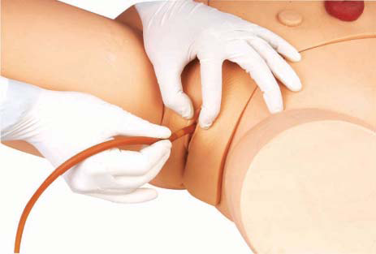
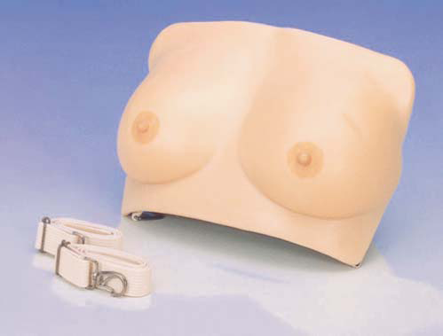
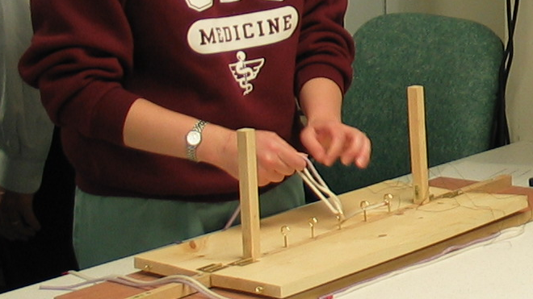
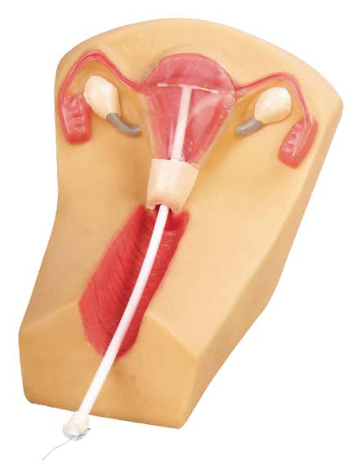
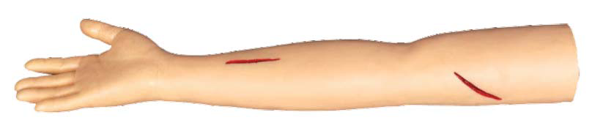
Task trainers
Mainly used for training in basic clinical skills
Examination of the rectum, breast.
Clinical procedures- suturing, catheterization, IUD

Slide 35
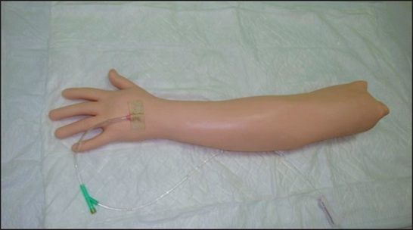
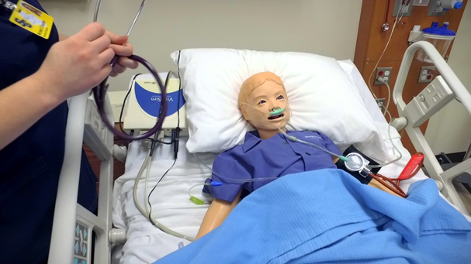
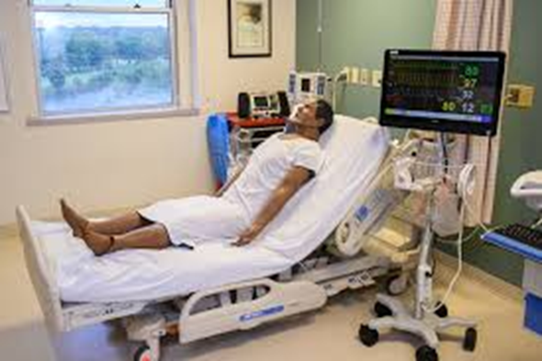
Low/Moderate/High Fidelity

Slide 36
Skill lab requirements of NMC
As per NMC website

Slide 37
Teaching team building skills
Interactive discussion with all participants for various examples
Role model of faculty/dept as working as Team at various occasions

Slide 38
Work place based teaching
real workplace environment along with relevant feedback
feedback from peers, coworkers, and patients (multi-source 360 degree feedback)
Bedside teaching/OPD based/Emergency cases
Learning during elective posting in III MBBS
CRMI interns assessment of competencies

Slide 39
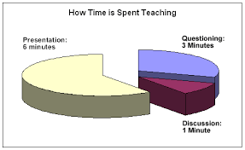
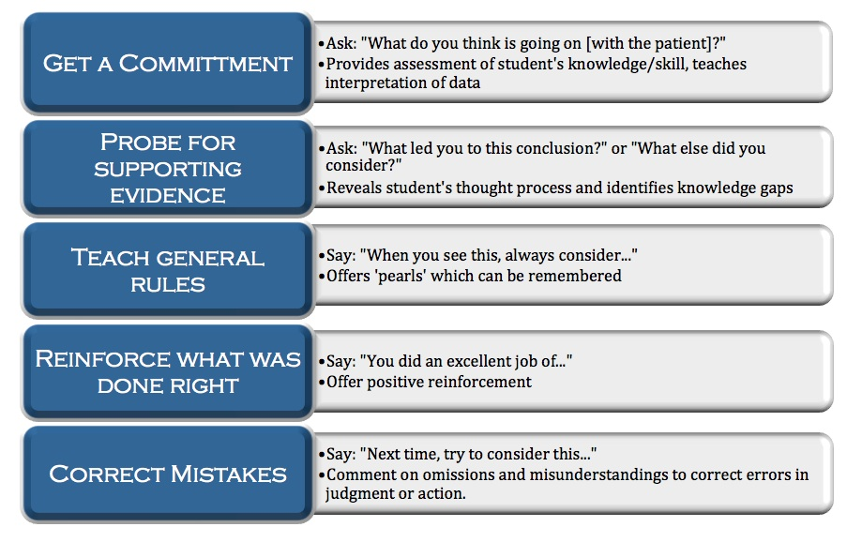
One minute preceptor

Slide 40
Wolpaw, Terry M MD; Wolpaw, Daniel R MD; Papp, Klara K PhD. SNAPPS: A Learner-centered Model for Outpatient Education. Academic Medicine 78(9):p 893-898, September 2003
Objective | Description
Summarize | Briefly summarize patient’s history and examination findings
Narrow | Present 2 or 3 differential diagnosis
Analyze | Discuss evidence supporting against each item on the differential diagnosis
Probe | Based on the prior 3 steps, ask preceptor questions to help shape consideration of the differential diagnosis and management
Plan | Present a proposal for managing the patient
Select | Choose a question to pursue self directed learning

Slide 41
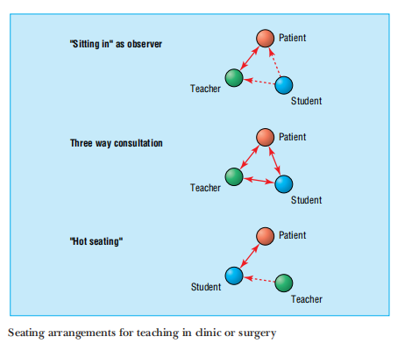
Spencer J. Learning and teaching in the clinical environment. Bmj. 2003 Mar 15;326(7389):591-4.

Slide 42
Challenges for effective Skill teaching
Number of students
Time constraints
Different levels of learners
Mismatched learner priorities
Infrastructure
Patient safety

Slide 43
Quality assurance in Teaching
Internal audit committee at MEU level & college level
Regular presentation of various finding in the MEU meetings
Six monthly or annual feedback from the students

Slide 44
Suggested readings
NMC website, Skills training, Module 5. Available at https://www.nmc.org.in/wp-content/uploads/2020/08/Skill-Module_23.12.2019.pdf
Sharma R, Badyal D, Sharma R, Seth S, Sharma M. Implementation of One-Minute Preceptor for Clinical Teaching in Obstetrics and Gynaecology. The Journal of Obstetrics and Gynecology of India. 2022, 73. 10.1007/s13224-022-01718-8.
Kapoor A, Kapoor A, Badyal DK. Simulated Patients for Competency-Based Undergraduate Medical Education Post COVID-19: A New Normal in India. Indian Pediatr. 2021;58:881-887.
Miller GE. The assessment of clinical skills/competence/performance. Academic Medicine : Journal of the Association of American Medical Colleges. 1990 Sep;65(9 Suppl):S63-7.

Slide 45

Thanks
Curriculum Implementation Support Program
Acknowledgments
NMC EXECUTIVE COMMITTEE ON FDP
Dr. Aruna Vanikar, President UGMEB, Chairperson EC-FDP, NMC New Delhi
Dr. Vijayendra Kumar, Member UGMEB, Co-Chair EC-FDP
Dr. Praveen R Singh, Assistant Dean, Professor Anatomy & Convener, NC PSMC Karamsad, Convener EC-FDP
Dr. Dinesh K Badyal, Vice-Principal, Professor Pharmacology, Convener NC CMC Ludhiana, Member EC-FDP
Dr. Sunita Vagha, Dean, faculty of Medicine & Prof. & Head Pathology Datta Meghe IMS, Sawangi, Wardha, Member EC-FDP
Dr. Praveen Iyer, Professor (Addl) Anatomy and Convener NC Seth GSMC & KEMH, Mumbai, Member EC-FDP
Dr. Pankaj Shah, Prof. & Head Community Medicine and Co-Convener NC SRMC & RI, Chennai, Member EC-FDP
Col. (Dr.) Naveen Chaudhary, Offg Senior Consultant, Academic Cell, UGMEB. Coordinator EC-FDP
This learning resource material is to aid the resource faculty to conduct the sessions in the course and they are encouraged to use creativity, activities to engage participants and achieve the learning objectives of the session.
DO NOT share this material outside MEU/CC/NC/RC group, to any other group, or WhatsApp groups.

